Slide 1
CanSat 2023 Critical Design Review (CDR) Outline Version 1.1
Team 1032
Yes we CANSAT

Slide 2
Presentation Outline
Page #​ | Presentation Section​ | Presenter(s)​
5​ | Systems Overview​ | Savari Datta, Jordi Rey, Daniel Horton
20 | Sensor Subsystem Design​ | Dylan Falzone
31 | Descent Control Design​ | Jovana Markovic, Melissa Gonzalez Grospe
41 | Mechanical Subsystem Design​ | Daniel Horton, Christian Roque, Savari Datta, Melissa Gonzalez Grospe
61 | Communication and Data Handling (CDH) Subsystem Design​ | Yashas Shivaram, Max Epstein
72 | Electrical Power Subsystem (EPS) Design​ | Paolo D’Alessandro
78 | Flight Software (FSW) Design​ | Max Epstein
89 | Ground Control System (GCS) Design​ | Dylan Falzone, Max Epstein
97 | CanSat Integration and Test​ | Jordi Rey
111 | Mission Operations & Analysis​ | Melissa Gonzalez Grospe​
117 | Requirements Compliance​ | Yashas Shivaram​
125 | Management​ | Savari Datta
Presenter: Savari Datta

Slide 3
Team Organization
Faculty Advisor
Ting Dong
Team Lead
Savari Datta
Junior
Container Subsystem
Payload & Aerodynamics
Payload Deployment
Avionics Subsystem
Flight Software
Container
Christian Roque
Freshman
Payload Lead
Jordi Rey
Junior
Aerodynamics Lead
Jovana Markovic Junior
Avionics Lead
Dylan Falzone
Junior
Flight Software
Max Epstein
Sophomore
Daniel Horton
Junior
Yashas Shivaram Junior
Melissa Gonzalez Grospe
Sophomore
Paolo D’Alessandro
Junior
Presenter: Savari Datta

Slide 4
Acronyms
Acronym | Meaning
ABS | Acrylonitrile Butadiene Styrene
CD | Drag Coefficient
CDH | Communication and Data Handling
CSV | Comma-Separated Values
DAC | Digital-to-Analog Converter
EPS | Electrical Power Subsystem
FSW | Flight Software
GCS | Ground Control System
GPS | Global Positioning System
IDE | Integrated Development Environment
LED | Light-Emitting Diode
MAE | Mechanical & Aerospace Engineering
Acronym | Meaning
MQTT | MQ Telemetry Transport
OTS | Off-the-shelf
PDR | Preliminary Design Review
PID | Proportional-Integral-Derivative
PWM | Pulse-Width Modulation
RPM | Revolutions per Minute
SMA | Subminiature Version A
SPI | Serial Peripheral Interface
SSDC | Space Systems Design Club
STEM | Science, Technology, Engineering, and Mathematics
UF | University of Florida
Presenter: Savari Datta

Slide 5
System Overview
Savari Datta, Jordi Rey, Daniel Horton

Slide 6
Mission Summary (1/2)
Main Objectives:​
Design a CanSat that shall consist of a container and a payload. The probe shall simulate the sequence of a planetary probe
​
The CanSat shall be launched to an altitude ranging from 670 meters to 725 meters above the launch site and deployed near apogee (peak altitude).
The CanSat must survive the forces incurred at launch and deployment.
Once the CanSat is deployed from the rocket, the CanSat shall descend using a parachute at a rate of 15 m/s.
At 500 meters, the CanSat shall deploy a probe that shall open a heat shield.
The heat shield will be used as an aerobraking device with a descent rate of 20 meters/second or less.
When the probe reaches 200 meters, the probe shall deploy a parachute and slow the descent rate to 5 meters/second.
Once the probe has landed, it shall attempt to upright itself and raise a flag 500 mm above the base of the probe.
The video camera shall be pointed towards the ground during descent.
Presenter: Savari Datta

Slide 7
Mission Summary (2/2)
Bonus Objectives:​
A video camera shall be integrated into the container and point toward the probe. The camera shall record the event when the probe is released from the container. Video shall be in color with a minimum resolution of 640x480 pixels and a minimum of 30 frames per second.
Will not be attempting bonus objective
External Objectives:​
To promote STEM engagement at the university level
To provide team members with valuable hands-on engineering project experience that includes designing, manufacturing and testing of an aerospace system
To challenge students with unique projects that require critical thinking
To inspire underclassmen to continue participating in the annual CanSat competition at UF
Presenter: Savari Datta

Slide 8
Summary of Changes Since PDR
Changes | Reason
Shape of the can was completely redesigned | We redesigned the can to withstand more G’s during shock. Additionally, the previous can configuration was found to not be very compatible with the probe design and the new configuration would allow the can to be sealed
One platform was removed from the probe | This will allow more room to fit the electronics
Platforms on the probe will be secured using both nuts and superglue instead of a double nut configuration | This will be more secure and save some mass budget
A method to seal the can from outside elements was developed | Secure the can from outside elements
Flag deployment mechanism moved to the bottom of the probe | Allowed for more stability for both the flag and the probe as a whole
Presenter: Savari Datta

Slide 9
System Requirement Summary (1/6)
Requirement Number​ | Description​
1​ | Total mass of the CanSat (science payloads and container) shall be 700 grams +/- 10 grams.
2​ | CanSat shall fit in a cylindrical envelope of 125 mm diameter x 400 mm length. Tolerances are to be included to facilitate container deployment from the rocket fairing.
3​ | The container shall not have any sharp edges to cause it to get stuck in the rocket payload section which is made of cardboard.
4​ | The container shall be a fluorescent color; pink, red or orange.
5​ | The container shall be solid and fully enclose the science probes. Small holes to allow access to turn on the science probes are allowed. The end of the container where the probe deploys may be open.
6​ | The rocket airframe shall not be used to restrain any deployable parts of the CanSat.
7​ | The rocket airframe shall not be used as part of the CanSat operations.
8​ | The container’s parachute shall not be enclosed in the container structure. It shall be external and attached to the container so that it opens immediately when deployed from the rocket.
9​ | The Parachutes shall be fluorescent Pink or Orange
10​ | The descent rate of the CanSat (container and science probe) shall be 15 meters/second +/- 5m/s.
11​ | 0 altitude reference shall be at the launch pad.
Presenter: Savari Datta

Slide 10
System Requirement Summary (2/6)
Requirement Number​ | Description​
12 | All structures shall be built to survive 15 Gs of launch acceleration.
13 | All structures shall be built to survive 30 Gs of shock
14 | All electronics and mechanical components shall be hard mounted using proper mounts such as standoffs, screws, or high-performance adhesives.
15 | All mechanisms shall be capable of maintaining their configuration or states under all forces.
16 | Mechanisms shall not use pyrotechnics or chemicals.
17 | Mechanisms that use heat (e.g., nichrome wire) shall not be exposed to the outside environment to reduce potential risk of setting vegetation on fire.
18 | Both the container and payload shall be labeled with team contact information including email address.
19 | Cost of the CanSat shall be under $1000. Ground support and analysis tools are not included in the cost. Equipment from previous years should be included in this cost, based on current market value.
20 | XBEE radios shall be used for telemetry. 2.4 GHz Series radios are allowed. 900 MHz XBEE radios are also allowed.
21 | XBEE radios shall have their NETID/PANID set to their team number.
22 | XBEE radios shall not use broadcast mode.
23 | The container and probe shall include an easily accessible power switch that can be accessed without disassembling the CanSat and science probes and in the stowed configuration.
Presenter: Savari Datta

Slide 11
System Requirement Summary (3/6)
Requirement Number​ | Description​
24 | The probe shall include a power indicator such as an LED or sound generating device that can be easily seen or heard without disassembling the CanSat and in the stowed state.
25 | An audio beacon is required for the probe. It shall be powered after landing.
26 | The audio beacon shall have a minimum sound pressure level of 92 dB, unobstructed.
27 | Battery source may be alkaline, Ni-Cad, Ni-MH or Lithium. Lithium polymer batteries are not allowed. Lithium cells must be manufactured with a metal package similar to 18650 cells. Coin cells are allowed.
28 | An easily accessible battery compartment shall be included allowing batteries to be installed or removed in less than a minute and not require a total disassembly of the CanSat.
29 | Spring contacts shall not be used for making electrical connections to batteries. Shock forces can cause momentary disconnects.
30 | The CanSat shall operate during the environmental tests laid out in Section 3.5.
31 | The CanSat shall operate for a minimum of two hours when integrated into the rocket.
32 | The probe shall be released from the container when the CanSat reaches 500 meters.
33 | The probe shall deploy a heat shield after leaving the container.
34 | The heat shield shall be used as an aerobrake and limit the descent rate to 20 m/s or less.
35 | At 200 meters, the probe shall release a parachute to reduce the descent rate to 5 m/s +/- 1m/sec.
Presenter: Savari Datta

Slide 12
System Requirement Summary (4/6)
Requirement Number​ | Description​
36 | Once landed, the probe shall upright itself.
37 | After uprighting, the probe shall deploy a flag 500 mm above the base of the probe when the probe is in the upright position.
38 | The probe shall transmit telemetry once per second.
39 | The probe telemetry shall include altitude, air pressure, temperature, battery voltage, probe tilt angles, command echo, and GPS coordinates that include latitude, longitude, altitude and number of satellites tracked.
40 | The probe shall include a video camera pointing down to the ground.
41 | The video camera shall record the flight of the probe from release to landing.
42 | The video camera shall record video in color and with a minimum resolution of 640x480.
44 | The flight software shall maintain a count of packets transmitted which shall increment with each packet transmission throughout the mission. The value shall be maintained through processor resets
45 | The probe shall maintain mission time throughout the whole mission even with processor resets or momentary power loss.
46 | The probe shall have its time set to within one second UTC time prior to launch.
47 | The probe flight software shall support simulated flight mode where the ground station sends air pressure values at a one second interval using a provided flight profile csv file.
48 | In simulation mode, the flight software shall use the radio uplink pressure values in place of the pressure sensor for determining the container altitude.
Presenter: Savari Datta

Slide 13
System Requirement Summary (5/6)
Requirement Number​ | Description​
49 | The container flight software shall only enter simulation mode after it receives the SIMULATION ENABLE and SIMULATION ACTIVATE commands.
50​ | The ground station shall command the CanSat to start calibrating the altitude to zero when the CanSat is on the launch pad prior to launch.
51​ | The ground station shall generate csv files of all sensor data as specified in the Telemetry Requirements section.
52​ | Telemetry shall include mission time with 0.01 second or better resolution.
53​ | Configuration states such as zero altitude calibration shall be maintained in the event of a processor reset during launch and mission.
54​ | Each team shall develop their own ground station.
55 | All telemetry shall be displayed in real time during descent on the ground station.
56 | All telemetry shall be displayed in engineering units (meters, meters/sec, Celsius, etc.)
57​ | Teams shall plot each telemetry data field in real time during flight.
58​ | The ground station shall include one laptop computer with a minimum of two hours of battery operation, XBEE radio and a hand-held antenna.
59​ | The ground station must be portable so the team can be positioned at the ground station operation site along the flight line. AC power will not be available at the ground station operation site
60​ | The ground station software shall be able to command the container to operate in simulation mode by sending two commands, SIMULATION ENABLE and SIMULATION ACTIVATE.
Presenter: Savari Datta

Slide 14
System Requirement Summary (6/6)
Requirement Number​ | Description​
61 | When in simulation mode, the ground station shall transmit pressure data from a csv file provided by the competition at a 1 Hz interval to the CanSat.
Presenter: Savari Datta

Slide 15
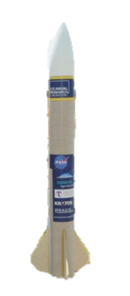

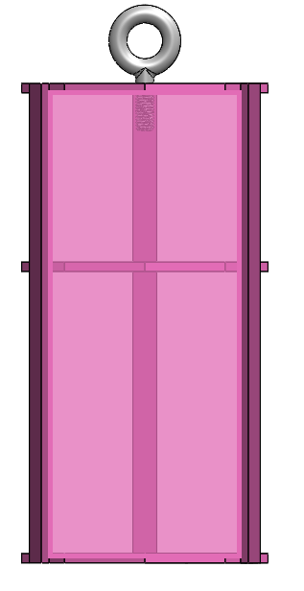
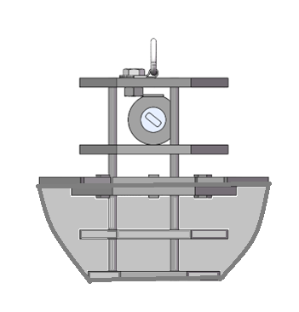
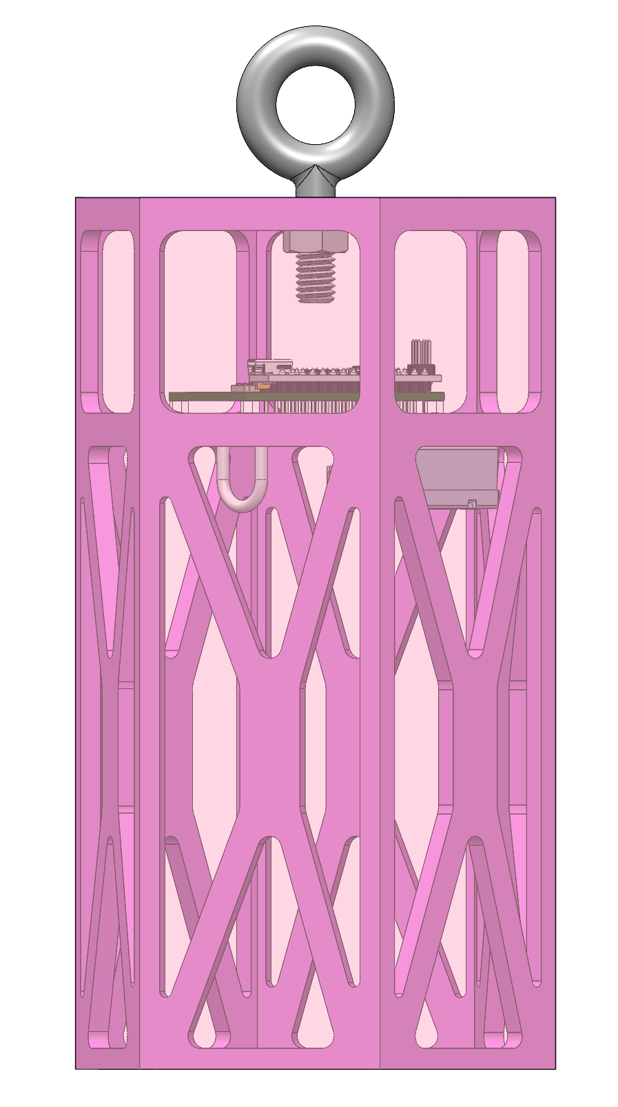
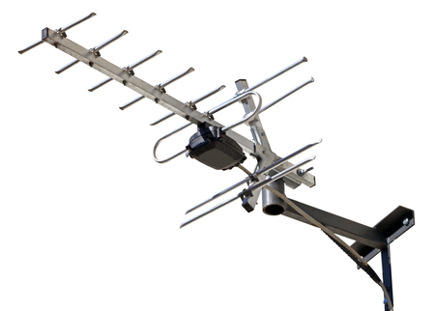

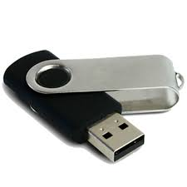
System Concept of Operations (CONOPS)
Set up ground station
Power on CanSat
Place CanSat into rocket
Rocket is launched
At 670-725m the CanSat separates and parachute opens
At 500m a probe will be released from the CanSat, which will deploy an aerobraking heat shield, with a camera facing the ground at all times
At 200m the probe will deploy a parachute too reduce descent rate
Probe will land upright
Probe will deploy a flag 500mm above the base of the probe
Recovery crew tracks and collects CanSat
FSW obtains and saves flight data & video recording to thumb drive
5
6
4
7
2
3
1
11
9
8
10
Presenter: Jordi Rey

Slide 16
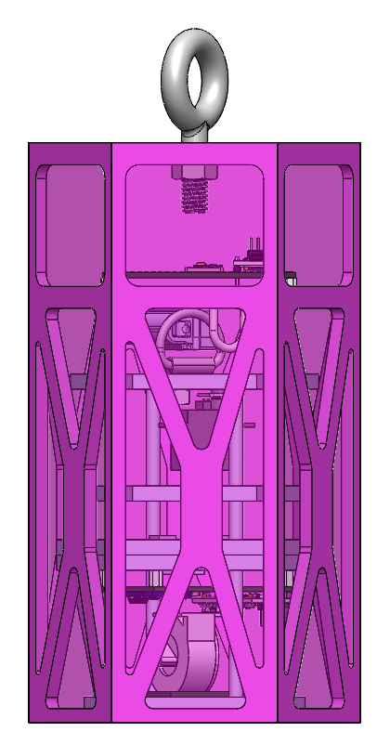
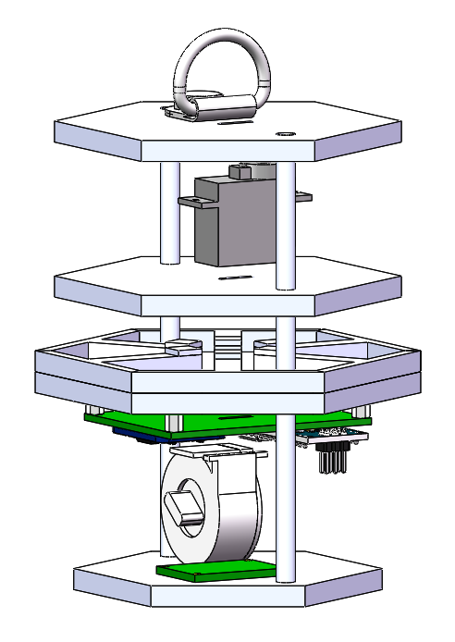
CanSat Physical Layout (1/2)
Launch Configuration
of CanSat
Launch Configuration
of Payload
251.45 mm
210.0 mm
122.58 mm
150.0 mm
100.0 mm
120.1 mm
Presenter: Daniel Horton

Slide 17
CanSat Physical Layout (2/2)
Launch Configuration
of CanSat
Eyebolt for Parachute
Launch Configuration
of Payload
Container
PCB
Tie-Down Ring
for Parachute
Linear
Actuator Payload Deployment System
Servo Motor to Release Flag
Payload
PCB
Flag Deployment Mechanism
Camera
Presenter: Daniel Horton

Slide 18
Launch Vehicle Compatibility (1/2)
148.55 mm
Mission Constrains | Dimension (mm)
Height | 400
Diameter | 125
251.45 mm
2.45mm
2.45mm
Property | Dimension (mm) | Clearance (mm)
Height | 251.45 | 148.55
Width | 120.1 | 2.45
ALL sharp edges will be sanded down.
Limited vertical protrusions (testing will be conducted to ensure no interference)
120.1 mm
Presenter: Jordi Rey

Slide 19
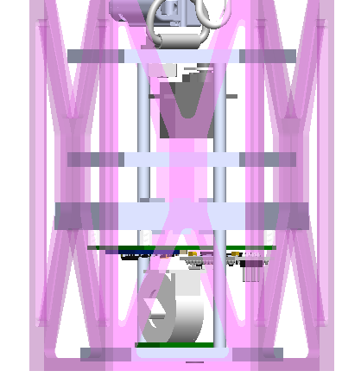
Launch Vehicle Compatibility (2/2)
Payload Clearance
Total clearance between payload and wall of container is 8.45 mm, 4.225 mm on each side.
ALL sharp edges will be sanded down.
80.0 mm
90.0 mm
100.0 mm
108.45 mm
Presenter: Jordi Rey

Slide 20
Sensor Subsystem Design
Dylan Falzone

Slide 21
Sensor Subsystem Overview
Sensor Type​ | Model​ | Purpose​ | CanSat Location​
GPS module​ | Adafruit Ultimate | Determine location coordinates (X,Y,Z) & exact time | ​Payload
Pressure Sensor​ | Adafruit BMP280 | Measure altitude of Container & Payload | Container, Payload
Rotational Sensor | BNO055 | Measure gyro readings in degrees per second, angular acceleration, and magnetometer readings in gauss | ​Payload
Temperature Sensor | BNO055 | Measure temperature readings | Payload
Camera​ | Arducam Mini 2MP Plus | View and record Earth’s terrain during descendent | Payload
Presenter: Dylan Falzone

Slide 22
Sensor Changes Since PDR
No changes have been made since the PDR
Presenter: Dylan Falzone

Slide 23
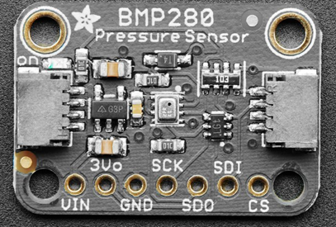
Payload Air Pressure Sensor Summary
Sensors​ | Current (at 1Hz) (µA)​ | Temperature Range (°C)​ | Interfaces​ | Resolution (hPa)​ | Voltage Usage (V)​ | Size (mm)​ L x W x H​ | Weight (g)​ | Price ($)​
Adafruit BMP280​ | 2.7​ | -40 to 85​ | I2C, SPI​ | .0016 | 1.71 ~ 3.6​ | 19.2 x 17.9 x 2.9 | 1.3​ | 9.95​
Selection​ | Reasoning for the selection​
Adafruit BMP280​ | - Lower current draw in comparison to . other inspected sensors - Greater resolution in comparison to . other inspected sensors
Data Processing
See Next Slide
Presenter: Dylan Falzone

Slide 24
Data Processing
double altittudeCalc(float P){
double sLP = 101325; //sea level pressures
double x = pow((P/sLP),(1/5.255));
double h = 44330 *(1-x);
return h;
//h = calculated altitude[m]
//P = sensed pressure[Pa]
//Po= sea level preasure[Pa]
}
Serial.print("Pressure: ");Serial.println(pres/3389.39 ); //inHg
Serial.print("Altitude: ");;Serial.println(altittudeCalc(pres)); //m
Presenter: Dylan Falzone

Slide 25
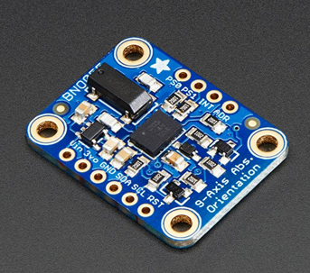
Payload Air Temperature Sensor Summary
Selection​ | Reasoning for the selection​
BNO 055 | - Familiarity with sensor - Also meets our requirements for . the payload’s rotational sensor - Availability
Sensors​ | Temperature Range (°C)​ | Interfaces​ | Voltage Usage (V)​ | Size (mm)​ L x W x H​ | Weight (g)​ | Price ($)​
BNO055 | -40 to 85​ | I2C or UART | 1.7 – 3.6 | 20 x 27 x 4 | 3 | 34.95
Data Processing
bno.getEvent(&orientation_events); Serial.println(); Serial.print(F("Temperature = ")); Serial.print(temp_event.temperature); Serial.println(" *C");
Presenter: Dylan Falzone

Slide 26
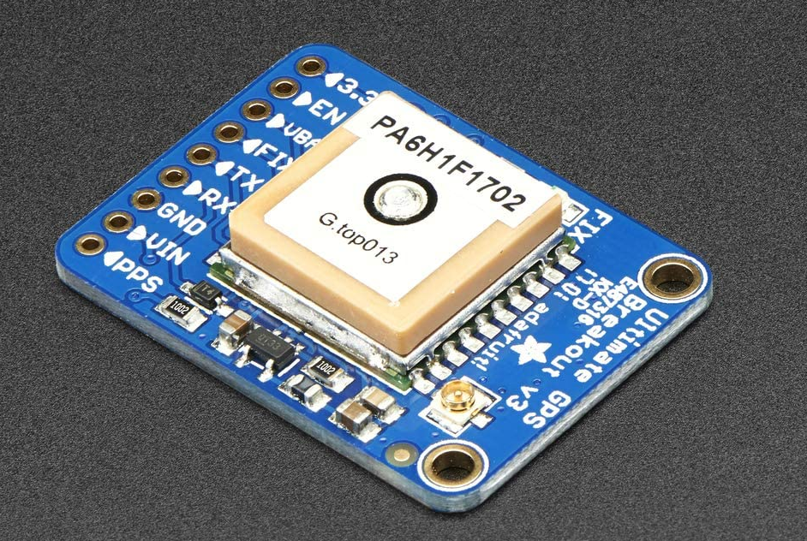
Payload GPS Sensor Summary
Selection​ | Reasoning for the selection​
Adafruit Ultimate | - Lower current draw during tracking in comparison to other inspected sensors - Previous experience with sensor and familiarity with Arduino - Availability
Sensors​ | Update Rate (Hz) | Operating Voltage (V)​ | Current (Tracking) (mA) | Interfaces | Size (mm)​ L x W x H​ | Weight (g)​ | Price ($)​
Adafruit Ultimate Breakout v3​ | 10​ | 3.0 – 5.0 | 20 | I2C, SPI, UART | 25.5 x 35 x 6.5 | 8.5 | 29.95​
Data Processing
Serial.print("Location: "); Serial.print(GPS.latitude, 4); Serial.print(GPS.lat); Serial.print(", "); Serial.print(GPS.longitude, 4); Serial.println(GPS.lon); Serial.print("Satellites: "); Serial.println((int)GPS.satellites);
Presenter: Dylan Falzone

Slide 27
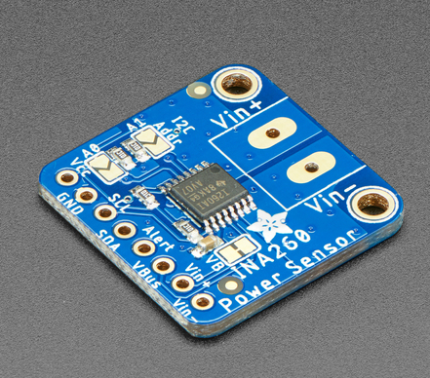
Payload Voltage Sensor Summary
Selection​ | Reasoning for the selection​
Adafruit INA260 | - Greater resolution bit compared to other sensors - Previous experience and familiarity with sensor - Availability
Sensors​ | Resolution | Interfaces | Size (mm)​ L x W x H​ | Weight (g)​ | Price ($)​
Adafruit INA260 | 16 bit | I2C | 22.9 x 22.8 x 2.7 | 2 | 9.95​
Data Processing
Serial.print("Current: "); Serial.print(ina260.readCurrent()); Serial.println(" mA"); Serial.print("Bus Voltage: "); Serial.print(ina260.readBusVoltage()); Serial.println(" mV"); Serial.print("Power: "); Serial.print(ina260.readPower()); Serial.println(" mW");
Presenter: Dylan Falzone

Slide 28
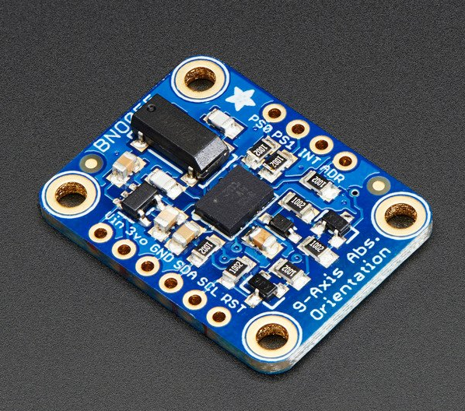
Payload Tilt Sensor Summary
Selection​ | Reasoning for the selection​
BNO055 | - Familiarity with sensor - Also meets our requirements for the payload’s Temperature sensor - Availability
Sensors​ | Temperature Range (°C)​ | Interfaces​ | Voltage Usage (V)​ | Size (mm)​ L x W x H​ | Weight (g)​ | Price ($)​
BNO055 | -40 to 85​ | I2C or UART | 1.7 – 3.6 | 20 x 27 x 4 | 3 | 34.95
Data Processing
Serial.print((float)orientation_events.orientation.x); Serial.print(F(" ")); Serial.print((float)orientation_events.orientation.y); Serial.print(F(" ")); Serial.print((float)orientation_events.orientation.z); Serial.println(F(""));
Presenter: Dylan Falzone

Slide 29
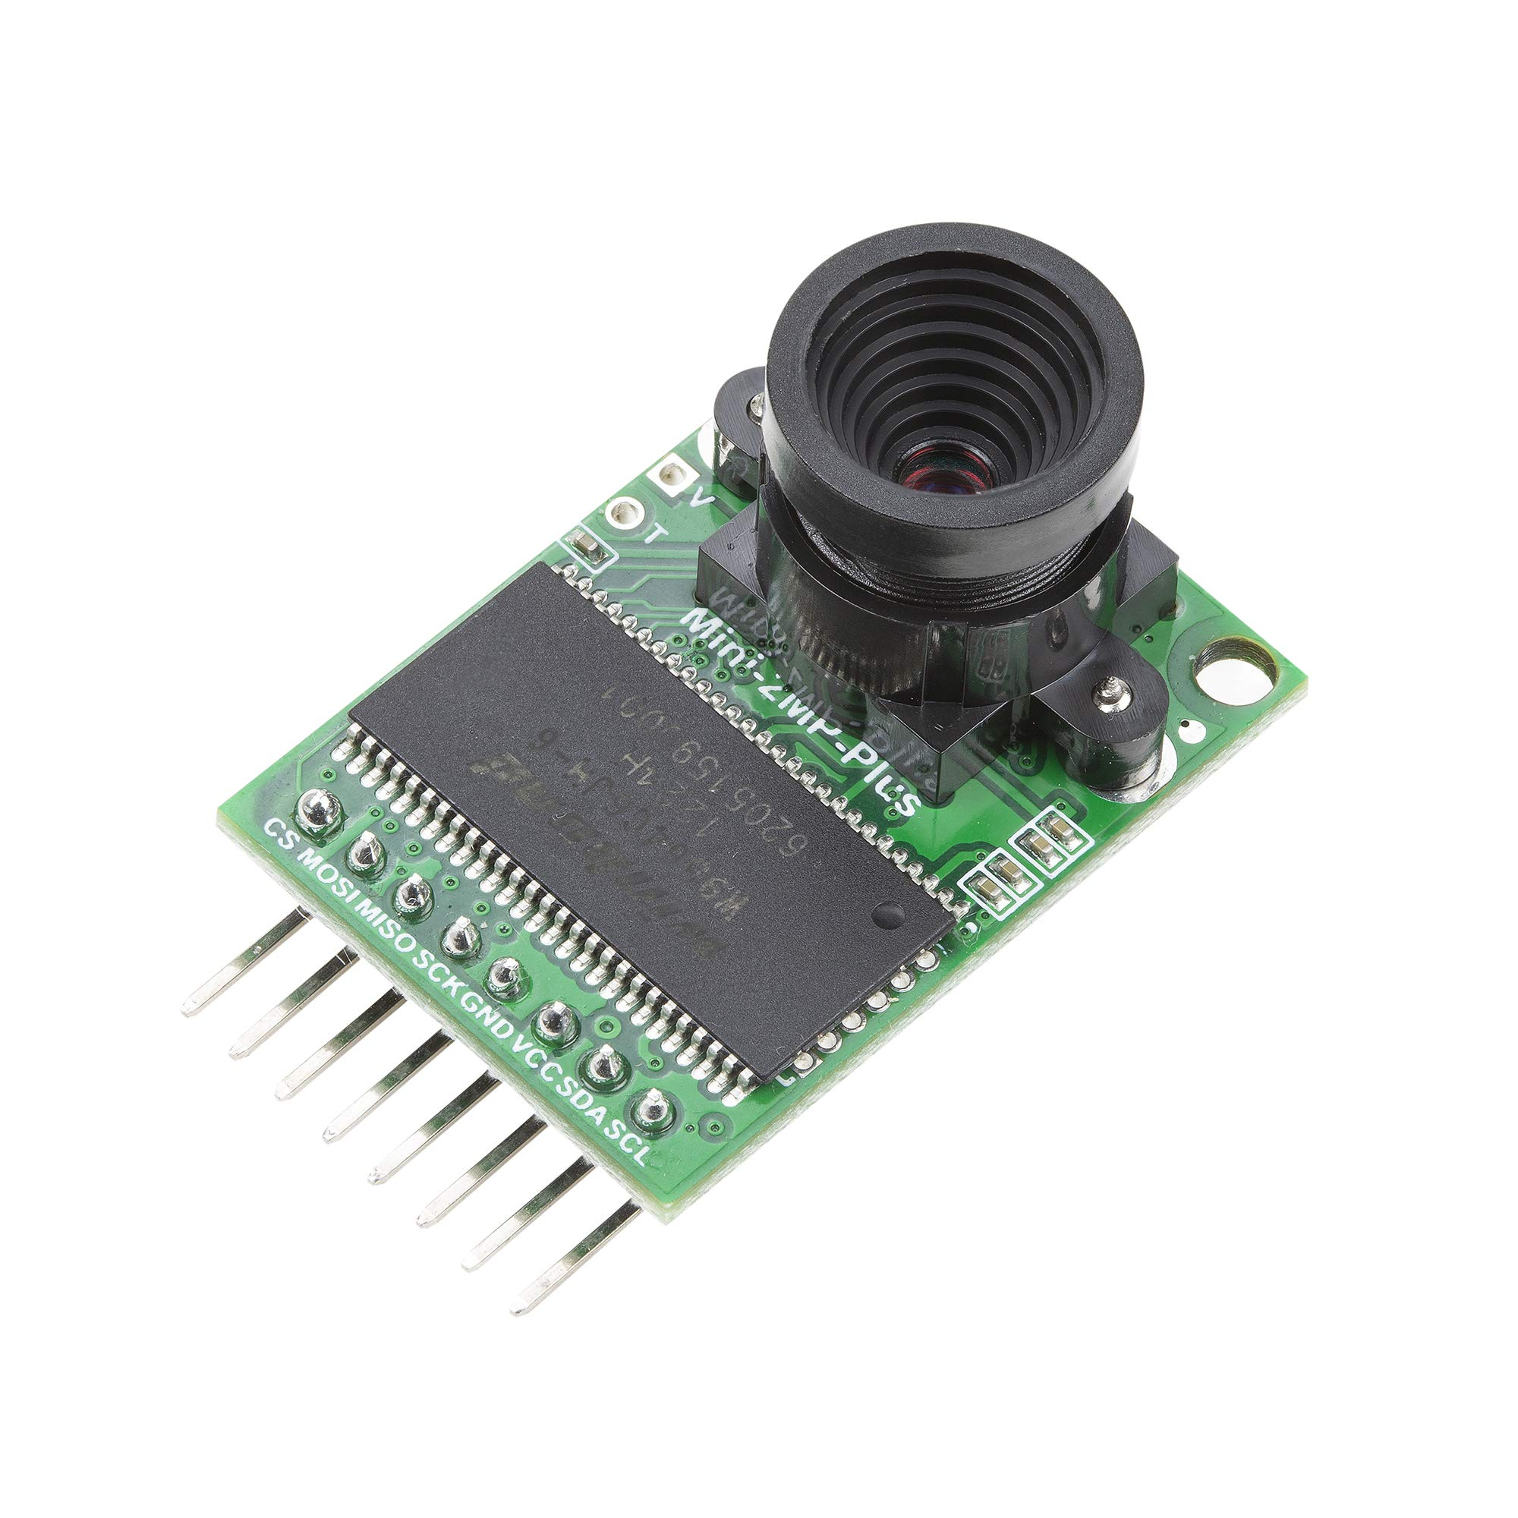
Camera Summary
Selection​ | Reasoning for the selection​
Arducam Mini 2MP Plus | - Compatibility with microprocessor - Lower current draw in comparison to other inspected sensors
Name ​​ | Price ($) ​​ | Weight (g)​​ | Size (mm)​​ | Operating​​ Voltage (V) ​​ | Current Draw (mA) | Framerate (fps)​
Arducam Mini 2MP Plus | 25.99 | 20 | 24 x 34 | 3.3 - 5.0 | 20 | 30
Data Processing
myCAM.start_capture(); Serial.println(F("start capture.")); total_time = millis(); while ( !myCAM.get_bit(ARDUCHIP_TRIG, CAP_DONE_MASK)); Serial.println(F("CAM Capture Done."));
Presenter: Dylan Falzone

Slide 30
Bonus Camera Summary
N/A
Presenter: Dylan Falzone

Slide 31
Descent Control Design
Jovana Markovic, Melissa Gonzalez Grospe

Slide 32
Descent Control Overview (1/2)
Can Descent:
Parachute is released at apogee to descend at 15m/s ± 5m/s
Probe released from the CanSat at 500m altitude
Container continues descent without the probe
Apogee
Ground
The parachute will be laid flat against the top of the can within the rocket
Parachute will be secured to the can using a fiberglass eyebolt and a double nut
Presenter: Melissa Gonzalez Grospe

Slide 33
Descent Control Overview (2/2)
Payload Descent:
ChuteRelease releases the parachute at 200m altitude
The probe deploys an aerobraking heatshield (outlined in pink) that slows decent to 20m/s or less
Probe continues descent at 5m/s ± 1m/s
500m
Release from can
Ground
The parachute will be held shut until 200m by a ChuteRelease (seen in green above), which will then pop open and allow the parachute to expand
The Chute release will be secured to the base of the parachute so that it is not lost after opening
Presenter: Melissa Gonzalez Grospe

Slide 34
Descent Control Changes Since PDR
No changes have been made since the PDR
Presenter: Melissa Gonzalez Grospe

Slide 35
Container Descent Control Hardware Summary
Container Descent Control | Model​
System | Parachute
System Components | Hexagonal Parachute
 | Parachute Chords
 | Eyebolt
Parachute sizing | 0.3048m in diameter
Parachute color | Orange
Eyebolt Screw sizing | 6.6675 cm long shank
Key design considerations | Weight, Simplicity, Stability
Testing | Parachute sizes tested
Presenter: Jovana Markovic

Slide 36
Payload Aerobraking Descent Control Hardware Summary
Aerobraking | Model​
System | Hexagonal Prism Payload Shape
System Components | Hexagonal Plates
 | Extendable arms which serve to enlarge one of the plates
 | Spring system which releases the arms into place
 | Mylar fabric for the heatshield
System overview | The spring system compresses arm attachments during payload storage. Upon deployment, the arms extend to enlarge the central hexagonal plate, forming a truncated hexagonal pyramid using the mylar fabric that increases drag
Key design considerations | Effortless ejection from can
Testing | Payload shape tested
Presenter: Jovana Markovic

Slide 37
Payload Descent Stability Control Design
Payload Descent Stability Control | Model​
System | Bottom heavy payload design
System Components | Hexagonal plates
 | Poles for vertical alignment
 | Electronics
 | Other mechanisms
Passive or Active | Passive
System overview | Contents of the payload are placed between the bottom plates to create a bottom-heavy design
Key design considerations | Ability to land upright Prevent tumbling
Testing | Ability to land upright tested
Presenter: Jovana Markovic

Slide 38
Payload Parachute Descent Control Hardware Summary
Payload Descent Control | Model​
System | Parachute
System Components | Hexagonal Parachute
 | Parachute Chords
 | Altimeter Chute Release
 | Tie-down ring
Parachute sizing | 0.53 m in diameter
Parachute color | Orange
System Overview | The parachute is fastened to a tie-down ring that's screwed onto the payload. It stays in place with the help of the device until the desired altitude is attained. Once reached, the device releases and the parachute deploys naturally.
Key design considerations | Components can easily fit within the can Effortless parachute deployment
Testing | Parachute size tested
Presenter: Jovana Markovic

Slide 39
Descent Rate Estimates (1/2)
Decent Rate Estimates for the following Configurations
Assumptions
~2.7 m/s winds
Total weight is 700 grams
Payload weight is 300 grams
0.53m Hexagon Parachute for Payload
Configuration | Device | Desired Rate | Decent Rate Estimate | Method of Calculation
CanSat with payload | Parachute | 15 ± 5 m/s | 15.3 m/s | Parachute calculations
Payload aerobraking | Umbrella Device | less than 20 m/s | 11.3 ± 3.1 m/s | Drop Testing
Payload parachute released | Parachute | 5 ± 1 m/s | 5.89 ± 1.1 m/s | Drop Testing
Presenter: Jovana Markovic

Slide 40
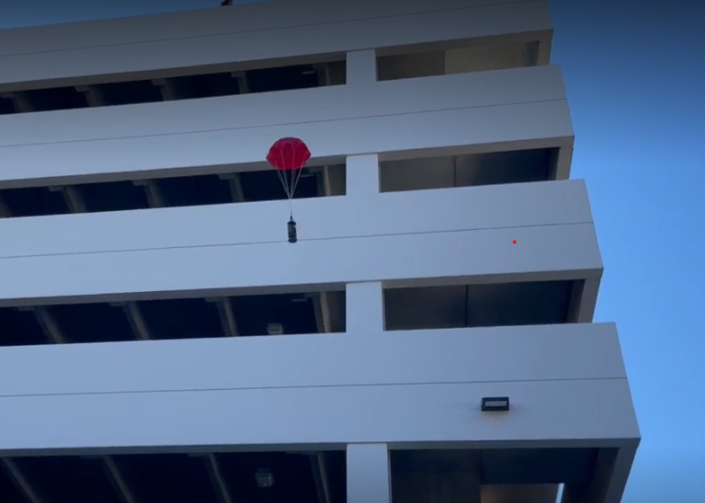
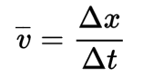
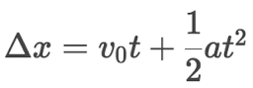
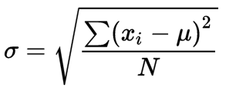
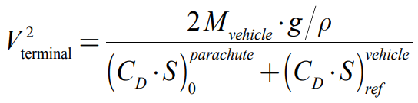
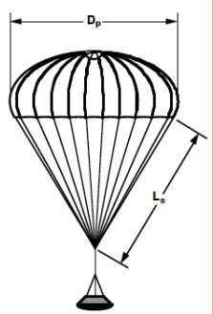
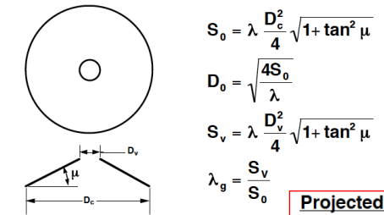
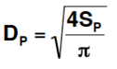

Descent Rate Estimates (2/2)
Testing Information
3D Printed Model of Container and Aerobraking device
Brass weights were used to simulate the weight of the interior components (700 grams & 300 grams)
Parachutes used were those selected from the Trade Study
Prototype was abruptly thrown in an attempt to mimic shock forces incurred at apogee
Each protype was tested 10 times and outliers were removed from each data set
Formulas Used
Formulas Retrieved from:
Section 3.5 Recovery Systems: Parachutes 101 - Utah State University. http://mae-nas.eng.usu.edu/MAE_6530_Web/New_Course/launch_design/Section7.5.pdf.
Presenter: Jovana Markovic

Slide 41
Mechanical Subsystem Design
Daniel Horton, Christian Roque, Savari Datta, Melissa Gonzalez Grospe

Slide 42

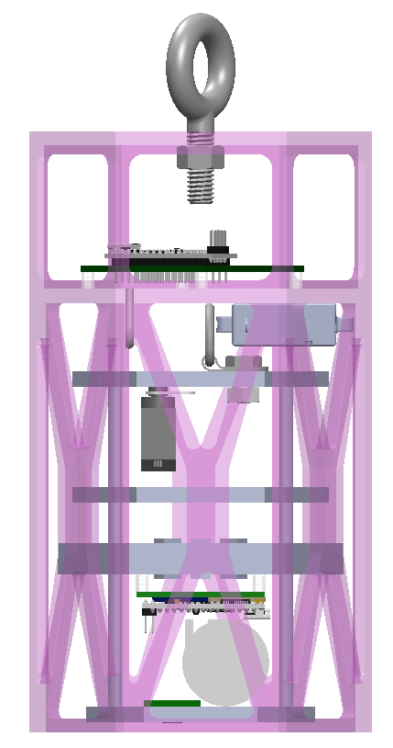
Mechanical Subsystem Overview
Parachute Attachment -
Lightweight fiberglass eyebolt providing mechanical connection between parachute and can.
ABS Hexagonal Canister -
3D-printed six-sided canister structure with separate compartments for containing the payload and avionics. Bottom is hollow to facilitate payload deployment. Wrapped in plastic wrap to enclose sides.
Payload Securement Ring -
Used to stop payload from sliding off linear actuator arm pre-deployment.
Flag Deployment Servo -
Holds flag inside of the payload until landing. When moved out of the way, the flag will deploy from the payload.
Linear Actuator -
Holds the payload inside the container through parachute ring when deployed. Can be retracted to release payload at the desired altitude.
Flag Spring Deployment -
a container will house a clock spring that will be used in reverse to simulate a tape measure that pushes outwards rather than inwards, raising the flag
Presenter: Daniel Horton

Slide 43
Mechanical Subsystem Changes Since PDR
The shape and structure of the can has been redesigned to withstand more force and allow for the can to be sealed
A platform has been removed from the probe design to have more room for electronics
Flag deployment mechanism moved to the bottom platform on the probe
Exit hole for the flag widened to fit the flag
Presenter: Daniel Horton

Slide 44
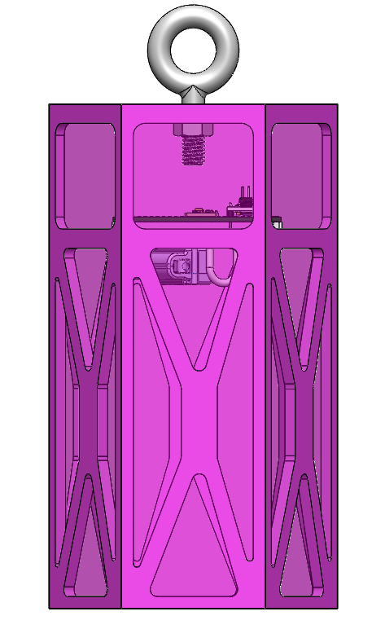
Container Mechanical Layout of Components
Parachute Attachment -
Lightweight fiberglass eyebolt providing mechanical connection between parachute and can.
Container PCB -
Mounted in container avionics bay and holds electrical components
used to control various subsystems.
Linear Actuator -
Holds the payload inside the container when deployed. Can be retracted to release payload at desired altitude.
251.45 mm
Payload Securement Ring -
Used to stop payload from sliding off linear actuator arm pre-deployment.
210.0 mm
ABS Structure –
Container is hexagonal shaped made of ABS plastic and colored pink.
150.0 mm
Plastic Wrap –
Container is wrapped in plastic wrap, which will be heated to create a tight casing.
120.1 mm
Presenter: Daniel Horton

Slide 45
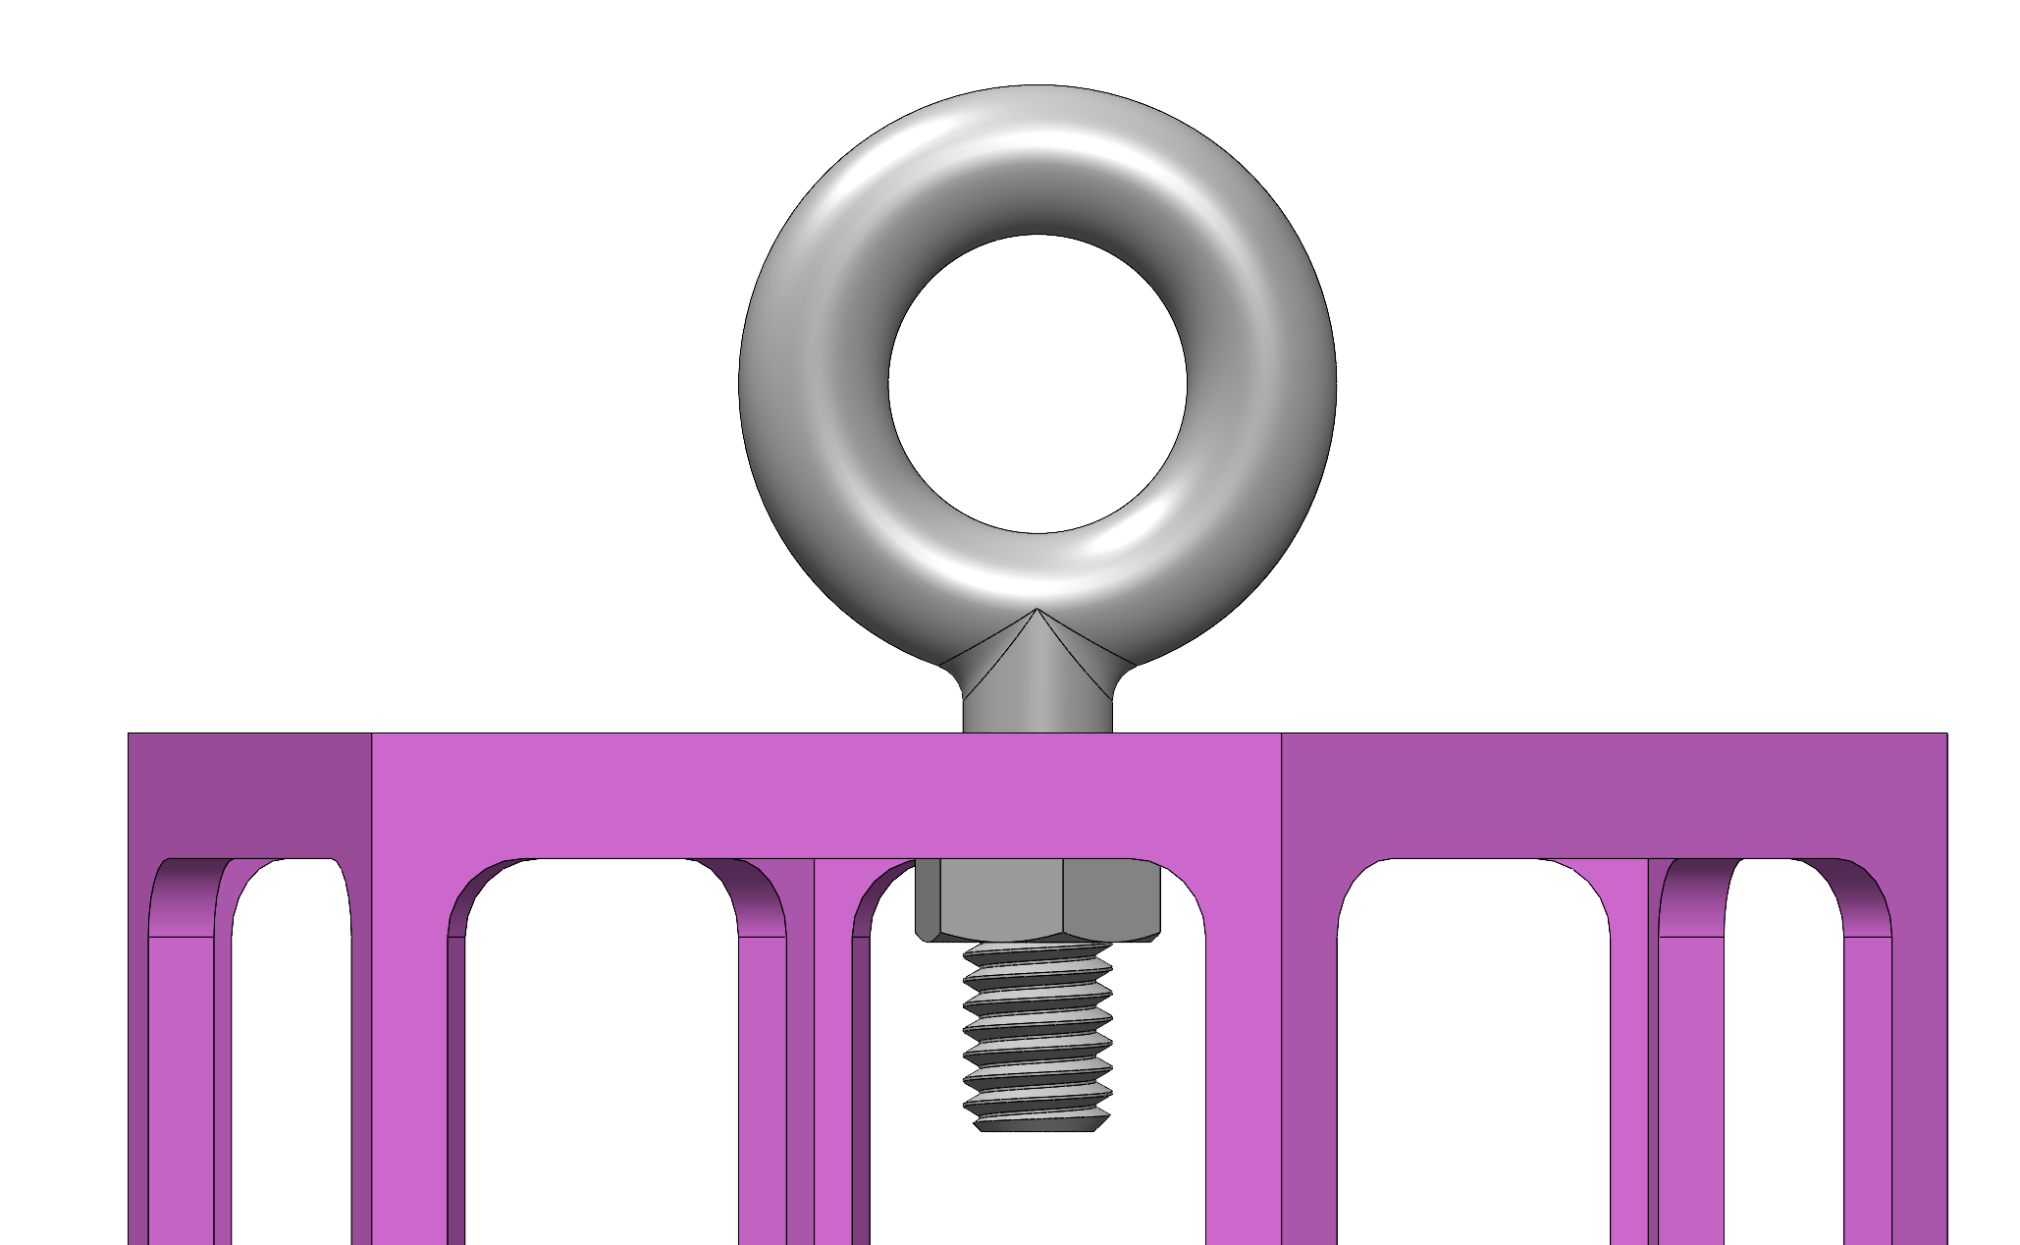
Container Parachute Attachment Mechanism
The parachute for the container will be connected via a fiberglass routing eyebolt that is attached to the top of the container using a nut.
Parachute- folded and placed on top of can within the rocket
Parachute lines
Eyebolt – Serves as the connection between the parachute and the container.
Nut – Tightly secures the Eyebolt to the container.
Presenter: Christian Roque

Slide 46
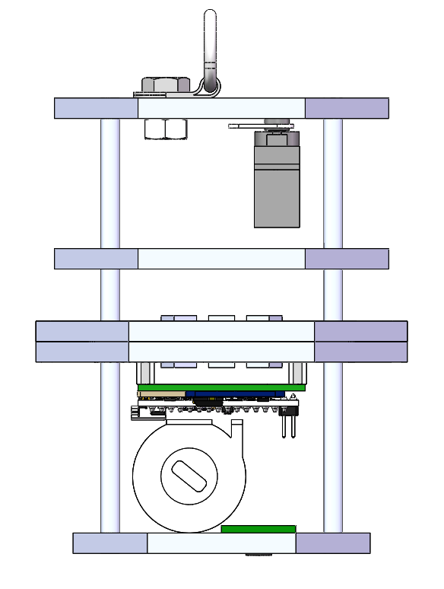
Payload Mechanical Layout of Components (1/2)
122.58 mm
82.0 mm
62.47 mm
80.0 mm
90.0 mm
100.0 mm
Presenter: Melissa Gonzalez Grospe
Notes:
Show structure (CAD model)
include dimension drawings
Identify location of electrical components
Identify payload attachment points
Identify major mechanical parts
mechanisms such as springs, hinges, etc.
Structural material selection(s)

Slide 47
Payload Mechanical Layout of Components (2/2)
Tie-Down Ring – Used to connect parachute to the payload. Additionally used to hold the payload inside the can pre-deployment.
Servo Motor – Used to release the flag out of the top of the payload.
10-32 Aluminum Rods – Used to provide a rigid support structure to the payload design and connect the ABS plates.
Heatshield mechanism – 6 ABS arms that will be deployed using springs once the payload leaves the can to open the heatshield and increase its aerobraking effect.
Payload PCB – Mounted upside down, holds necessary avionics. Hole in center allows the flag deployment mechanism to run through it.
Camera – Hole cut in bottom plate to point lens at the ground.
ABS Plates – Plates provide mounting points for electronic and mechanical components. Flat-bottomed design provides level surface for landing.
Presenter: Melissa Gonzalez Grospe
Notes:
Show structure (CAD model)
include dimension drawings
Identify location of electrical components
Identify payload attachment points
Identify major mechanical parts
mechanisms such as springs, hinges, etc.
Structural material selection(s)

Slide 48
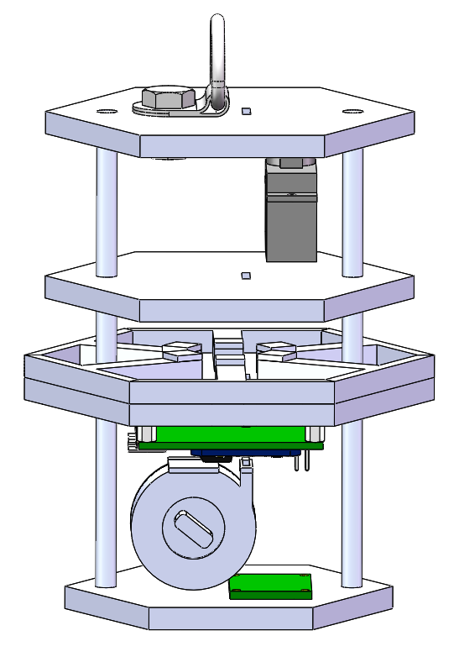
Payload Pre Deployment Configuration
Tie-down Ring is used to keep the payload inside the container until deployment.
PCB, Flag Deployment, Camera, Servo Motor are mounted to the payload to be secured in place. The Tie-down Ring is secured through a hex-nut and screw.
Spring Loaded Arms are kept in pre deployment positioning by pushing on the inside walls of the container.
Presenter: Melissa Gonzalez Grospe
Notes:
Show payload in stowed configuration
Explain how the payload is secured in place.
How are all parts held in the stowed position.

Slide 49
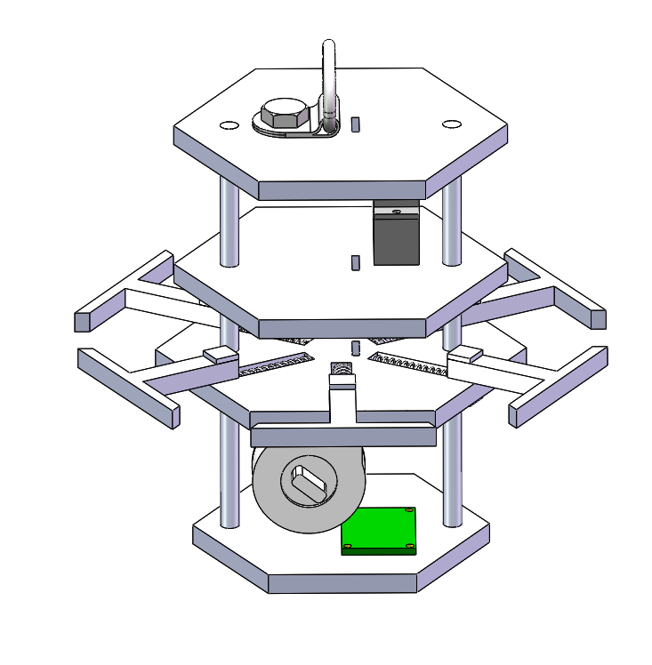
Payload Aerobraking Deployment Configuration
Spring Loaded Arms are released once payload is deployed from container. This creates a hexagonal prism shape which implements the heat shield.
Presenter: Melissa Gonzalez Grospe
Notes:
Show payload in deployed configuration
Explain any changes to the payload configuration when it is released.
Explain release mechanisms

Slide 50
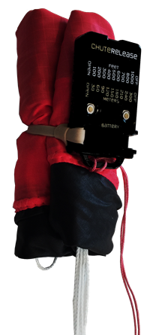
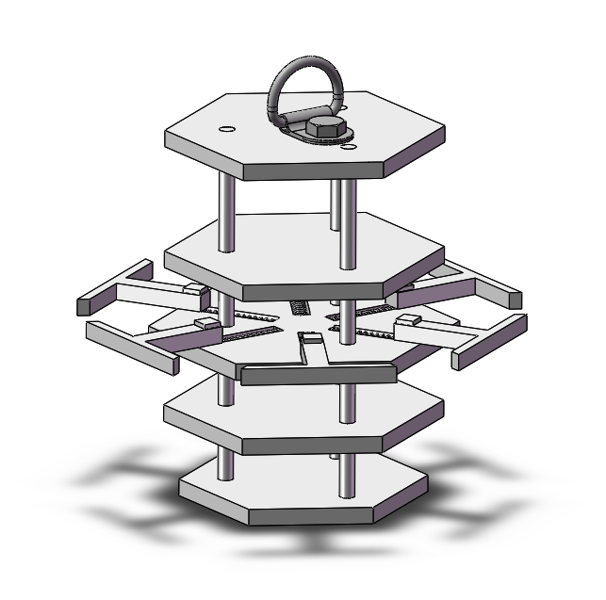
Payload Parachute Deployment Configuration
At 200m altitude, the Chute release will open and deploy the parachute. The ChuteRelease device will remain attached to the probe through a line (shown in green).
The parachute will originally be held shut by the ChuteRelease device, as seen in the first configuration
Parachute lines
ChuteRelease
Presenter: Christian Roque

Slide 51
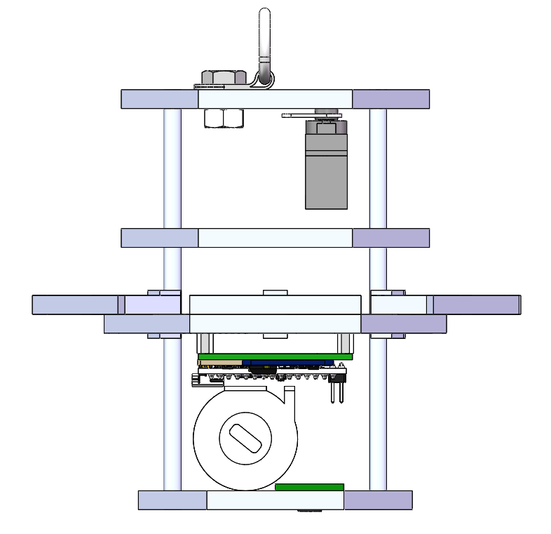
Payload Uprighting Description
Locating the majority of the payload's mass in its lowermost section ensures that the bottom will remain pointed towards the ground.
Additional weights will be added to the bottom platform depending on remaining mass budget after assembly
The umbrella-shaped heatshield is designed such that the payload will maintain a stable orientation during free-fall and landing.
The wide, flat bottom provides a stable and level surface for the payload when landing, ensuring that it will not tip over.
Mylar Heatshield Outline
Payload consistently landed with correct orientation during drop testing of a representative model.
Presenter: Christian Roque

Slide 52
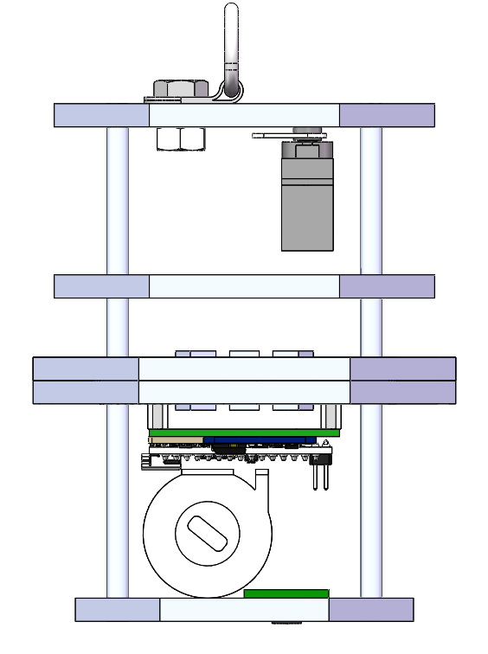
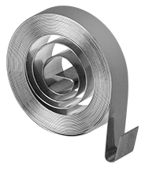
Payload Flag Deployment Configuration
Inside the Flag Deployment Mechanism
The flag will be partially expanded within the probe
The flag will be held down from full expansion by a servo motor, which will move out of the way when time for release
The clock spring will be reversed so that the steel tape is pushed outward
Clock spring
Servo Motor
Flag “pole”
114.3mm
Note: the flag will be attached using super glue. The material will be ripstop nylon and the flag will be triangular.
Flag deployment mechanism
Presenter: Savari Datta

Slide 53
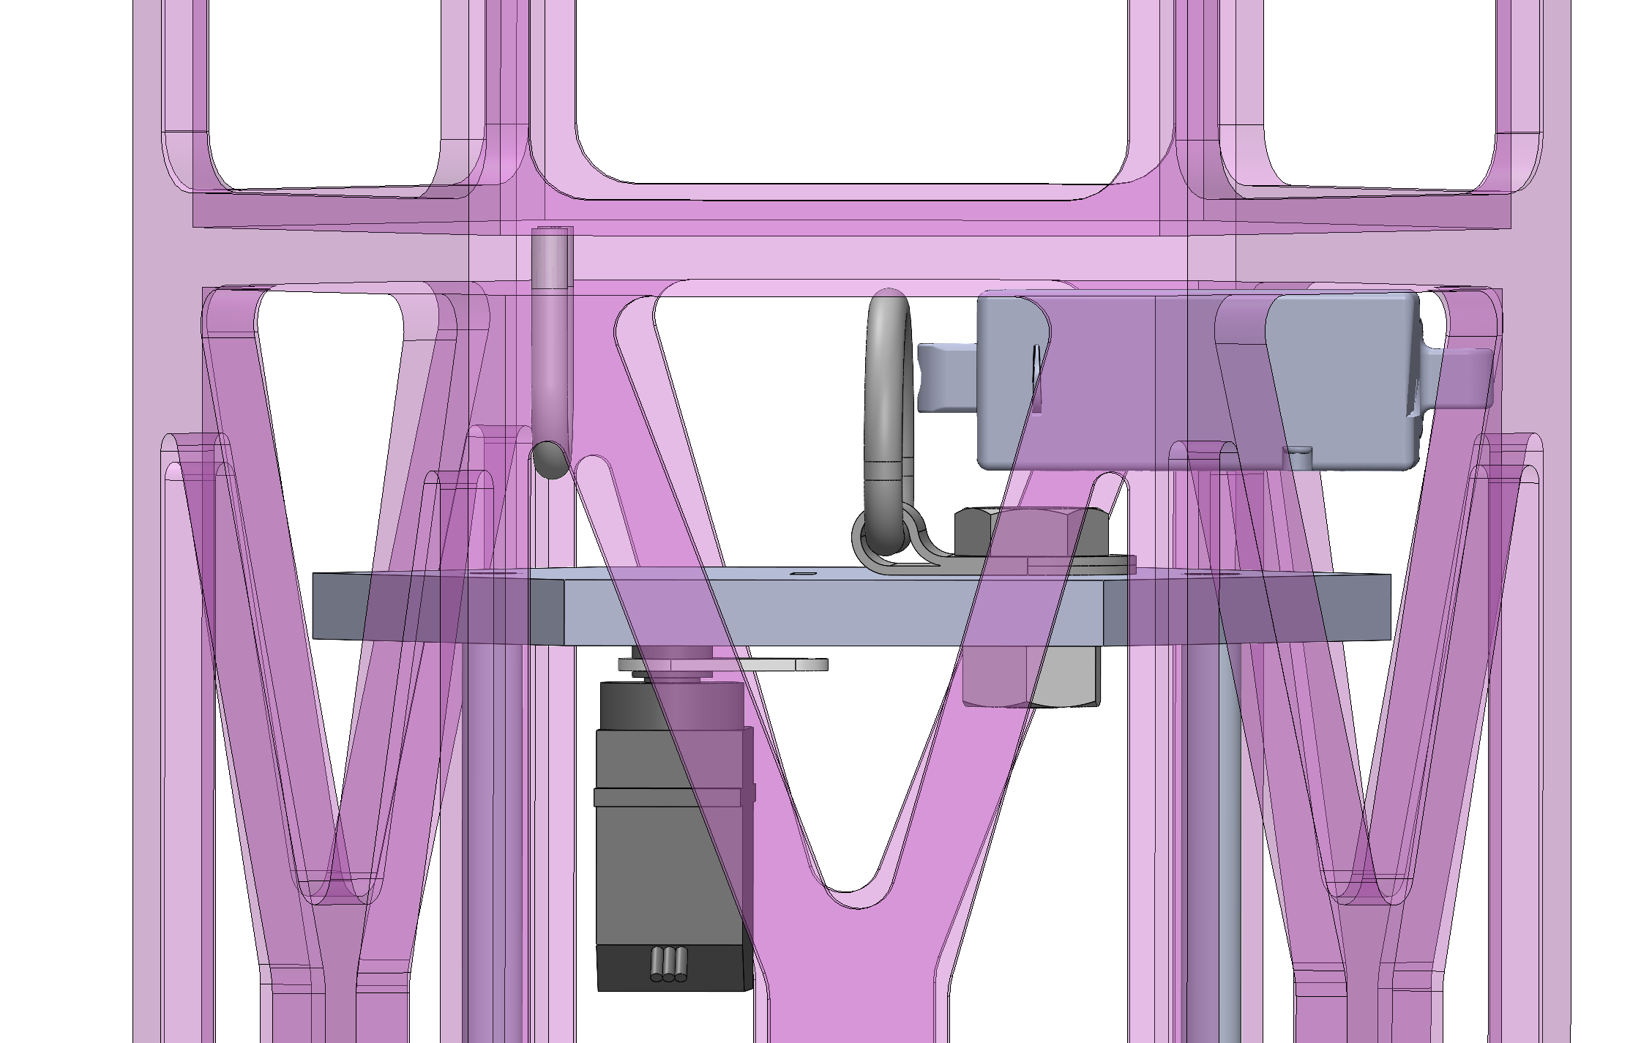
Container Payload Mount
Pre-Release Configuration:
To hold the payload inside the can, the linear actuator is deployed through the tie-down ring of the payload and into the payload securement, mounted opposite of it, which stops the payload from sliding off during descent.
Released Configuration:
At 500 m, the linear actuator is retracted, allowing for the payload to drop through the bottom of the can.
Presenter: Savari Datta
Notes:
Show how payload is secured in the container.
Show how the payload is released from the container.

Slide 54
Structure Survivability
The PCBs for the container and the payload are mounted to the plates using standoffs which are screwed into the plastic
The various electrical connections/components will be soldered to the PCB, securing them in place
The eyebolt (container) and the tie down ring (payload) are used for parachute attachment deployed during descent
The canister and payload were designed with adequate thickness and strength to survive 15 g's of acceleration without buckling or yielding.
The canister and payload will both be tested for shock force resistance according to the environmental test plan.
Presenter: Savari Datta
Notes:
As applicable for the Payload and Container, discuss:
Electronic component mounting methods
Electronic component enclosures
Acceleration and shock force requirements and testing
Securing electrical connections (glue, tape, etc.)
Consider required judge verification during pre-flight check in
Descent control attachments

Slide 55
Container Mass Budget
Part Name​ | Mass (g)​ | Source​ | Uncertainty (±g)​
Fiber Glass Routing Eyebolt | 2.40 | Datasheet | ​-
¼- 20 Aluminum Hex Nut | 0.50 | Datasheet | ​-
ABS Can Structure | 206.00 | Estimate | 4.65
Payload Securement Ring | 0.30 | Estimate | 0.02
1ft Ultra-Light Parabolic Parachute | 9.07 | Datasheet | -
Plastic Wrap | 3.00 | Estimate | 0.34
Total Mass: 221.27 grams
Presenter: Savari Datta

Slide 56
Electronics Mass Budget (Container)
Part Name​ | Mass (g)​ | Source​ | Uncertainty (±g)​
Adafruit BMP280​ | ​1.30 | ​Datasheet | ​-
​Arduino Nano | ​7.00 | ​Datasheet | ​-
2032 Cell Batteries | 6.20 | Datasheet | -
Linear Actuator | 15.00 | Datasheet | -
Linear Actuator Ring | 0.20 | Datasheet | -
Plastic Coupling Nuts | 0.40 | Datasheet | -
PCB Screws | 0.10 | Datasheet | -
Total Mass: 30.20 grams
Presenter: Savari Datta

Slide 57
Payload Mass Budget (1/2)
Part Name​ | Mass (g)​ | Source​ | Uncertainty (±g)​
Springs | 0.30 | Datasheet | ​-
Heat Shield Arms | 14.10 | Measured | ​0.01
ABS Platforms | 138.30 | Estimate | 3.46
Flag Release | 6.84 | Estimate | 0.18
Steel Tape | 1.00 | Measured | 0.01
Super Lube | 1.00 | Measured | 0.01
Clock Spring | 7.80 | Datasheet | -
¼-20 Aluminum Screw | 0.70 | Datasheet | -
¼ - 20 Aluminum Hex Nut | 8.50 | Datasheet | -
Tie Down Ring | 9.00 | Datasheet | -
JB Weld Plastic Bonder | 2.00 | Estimate | 0.27
Presenter: Savari Datta

Slide 58
Payload Mass Budget (2/2)
Part Name​ | Mass (g)​ | Source​ | Uncertainty (±g)​
2ft Ultra-Light Parabolic Parachute​ | 17.00​ | Datasheet​ | ​-
Aluminum threaded rods ​ | 9.80​ | Datasheet | ​-
Mylar Reflective Material​ | ​112.10 | ​Estimate | 3.36
Ripstop Nylon | 5.50 | Estimate | 0.02
Additional Weights | 30.00 | Datasheet | -
Total Mass: 363.94 grams
Presenter: Savari Datta

Slide 59
Electronics Mass Budget (Payload)
Part Name​ | Mass (g)​ | Source​ | Uncertainty (±g)​
Adafruit BMP280 | ​1.30 | ​Datasheet | ​-
BNO-055 | 3.00 | Datasheet | ​-
Adafruit Ultimate | 8.50 | Datasheet | -
Raspberry Pi Pico | 3.00 | Datasheet | -
ANT-900-RP-2-A | 5.00 | Measured | 0.05
Arducam Mini | 20.00 | Datasheet | -
Micro SD Cards | 1.00 | Datasheet | -
Micro SD Readers | 3.40 | Datasheet | -
XBEE Pro 900 Mhz Radio | 5.00 | Datasheet | -
2032 Cell Batteries | 6.20 | Datasheet | -
Servo Motor | 9.00 | Measured | 0.09
Jolly Logic Chute Release | 17.20 | Datasheet | -
Total Mass: 82.60 grams
Presenter: Savari Datta

Slide 60
Total Mass Budget
Component of the CanSat | Total Mass (g)​
Container | 221.27
Electronics for Container | 30.20
Payload | 363.94
Electronics for Payload | 82.60
Mass Totals
Mass (g) | Margin [+, -] (g) | Requirement Total (g)
698.01 | ±12.47 | 700 ± 10
Current mass of the CanSat is 698.01 grams
After can assembly is finished, mass will be reevaluated
If mass comes out below 690 grams, extra mass will be used to reinforce the can structure and payload
If mass comes out over 710 grams, measures will be taken to reduce the mass such as decreasing the in-fill of 3D-printed material or reducing the extra weight added to the payload
Presenter: Savari Datta
Notes:
Table(s) providing the following:
Mass of each component of payload and container
Mass of each structural element
Sources/uncertainties – whether the masses are estimates, from data sheets, measured values, etc.
Total mass of all components and structural elements
Margin : The amount of mass (in grams) in which the mass budget meets, exceeds, or falls short of the mass requirement
Method of correction to meet mass requirement (based on the margin listed above)
Must clearly distinguish between Container and Payload masses

Slide 61
Communication and Data Handling (CDH) Subsystem Design
Max Epstein, Yashas Shivaram

Slide 62
CDH Overview
Device Type​​ | Model​​ | Purpose​​
Processor & Memory​ | Raspberry Pi Pico | Facilitate data storage, sensing, communication​
Real-Time Clock​ | Adafruit Ultimate Breakout v3 GPS Module​ | Keep track of times for data & calculation purposes​
Antenna​ | ANT-900-RP-2-A | Transmit/receive data from radio/processor configuration​
Radio​ | XBEE-PRO 900HP | Communicate between antennae & processors​
Presenter: Yashas Shivaram

Slide 63
CDH Changes Since PDR
No changes have been made since the PDR
Presenter: Yashas Shivaram

Slide 64
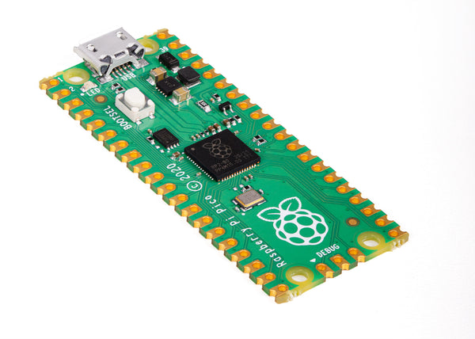
Payload Processor & Memory Selection
Processor | Boot time(s) | Speed (Mhz) | Memory (KB) | Weight (g) | Dimension (mm) | Voltage Input (V) | Ports
Raspberry pi Pico | 0.5 | 125 | 264 | 3 | 51.3x21 | 1.8 – 5.5 | Analog Input - 4 PWM Output - 8 I2C I/O – 1 SPI – 1 DAC Output - 1
Selection​ | Reasoning for selection​
​Raspberry Pi Pico | - Compact size​ - Compatibility with camera/Familiarity ​ - Availability
Presenter: Yashas Shivaram

Slide 65
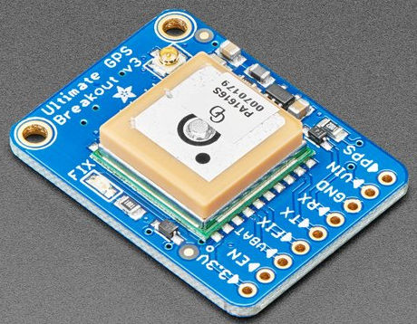
Payload Real-Time Clock
Real-Time Clock Keeper​ | Tolerance Reset​ | Interface | Cost ($)
Arduino Ultimate Breakout v3​ | Real-Time clock continues keeping time in the event of a reset ​ | Internal to GPS | 0.00
Selection​ | Reasoning for selection​
Adafruit Ultimate GPS Breakout | - Already part of the board - GPS Module will have an independent battery backup - No additional weight, size, or circuitry required
Presenter: Yashas Shivaram

Slide 66
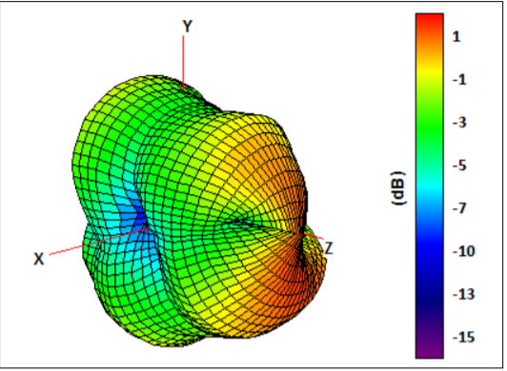
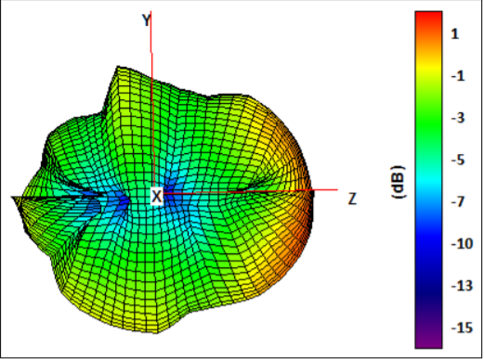
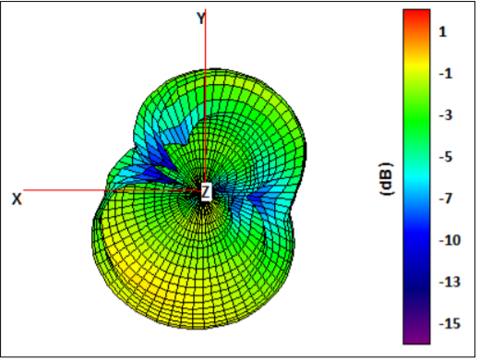
Payload Antenna Selection
Name​ | Frequency ​ Range (GHz)​ | Length of Antenna (mm)​ | Gain (dBi)​ | Polarization | Connection Type​ | Weight (g)
ANT-900-RP-2-A | ​ .880-.960 | 115 | 2​.1 | (Linear) Vertical | ​SMA​ | 11
Selection​ | Reasoning for selection​
ANT-900-RP-2-A | - In accepted frequency range - Compatible with selected radio - Relatively small size
Presenter: Yashas Shivaram

Slide 67
Payload Radio Configuration
Name​ | Frequency ​ Range (GHz)​ | Outside Range (km) | Antenna Type​ | Weight (g) | Cost ($)
XBEE-PRO 900HP | .902 - .928 | 6.5​ | ​RPSMSA | 6.9 | 68
Selection​ | Reasoning for selection​
XBEE-PRO 900HP | - Operates on accepted frequency - Excellent outside range
NETID/PANID – 1032
Transmission Control​
- Data will be continuously sent at 1 Hz during all stages of flight - Transmission will be handled by FSW, starting on power on and ending once the container and payload have landed
Presenter: Yashas Shivaram

Slide 68
Payload Telemetry Format
Transmitted Data will be saved to a .csv file on ground station.
Data Transmitted:
To GCS at 1 Hz packet transmission rate:
Payload sensor readings (Air pressure/temperature, mission time, GPS time, coordinates, power supply voltage, tilt, altitude, and various states)
How is the data formatted?
-Payload-to-GCS:
-<TEAM_ID>,< MISSION_TIME>, <PACKET_COUNT>, <MODE>,
<STATE>, <ALTITUDE>,<HS_DEPLOYED>,<PC_DEPLOYED>,<MAST_RASIED> <TEMP>, <VOLTAGE>, <PRESSURE>,< GPS_TIME>, <GPS_ALTITUDE>, <GPS_LATITUDE>, <GPS_LONGITUDE>, <GPS_SATS>, <TILT_X>,<TILT_Y>, <CMD_ECHO>
Example:
1063,13:35:59,25,F,LAUNCH_WAIT,N,N,N,25.3,8.3,230,13:35:35,25,150.0258,168.6765,58,5.02,3.05,CXON
Presenter: Max Epstein

Slide 69
Payload Telemetry Format
Telemetry Field​ | Purpose​​ | Relayed From:​
<TEAM_ID>​ | Team ID number (1063)​ | Payload
<MISSION_TIME>​ | UTC time from RST=0 in 1st software state (hh:mm:ss)​
<PACKET_COUNT>​​ | # of packets transmitted across all devices​
<MODE>​ | 'F' = Flight (default) mode, 'S' = Simulation mode​
<STATE>​ | Software State (STARTUP, DESCENT, etc.)​
<ALTITUDE>​ | Altitude in meters relative to ground level​ (+/- 0.1 m)
<HS_DEPLOAYED>​ | ‘P’ if the probe has been deployed, ‘N’ if not
<PC_DEPLOAYED>​ | ‘C’ if the probe parachute has been deployed, ‘N’ if not
<MAST_RAISED>​ | ‘M’ if the flag has been raised, ‘N’ if not
<TEMP>​ | The temperature in degrees Celsius (+/- 0.1C)
Presenter: Max Epstein

Slide 70
Payload Telemetry Format
Telemetry Field​ | Purpose​​ | Relayed From:​
<PRESSURE>​ | The air pressure in kPa (+/- 0.1 kPa) | Payload
<VOLTAGE>​ | Voltage reading of Container power bus​ (+/- 0.1 V)
<GPS_TIME>​ | UTC time generated from GPS (hh:mm:ss)​ (+/- 1 sec)
<GPS_LATITUDE>​ | GPS latitude coordinate in decimal degrees​ (+/- 0.0001 degrees North)
<GPS_LONGITUDE>​ | GPS longitude coordinate in decimal degrees​ (+/- 0.0001 degrees West)
<GPS_ALTITUDE>​​ | GPS altitude coordinate in decimal degrees​ (+/- 0.1 m from sea level)
<GPS_SATS>​ | # of satellites being tracked by GPS​
<TILT_X>​ | The angle of the payload in the x direction in degrees (+/- 0.01)
<TILT_Y>​ | The angle of the payload in the y direction in degrees (+/- 0.01)
<CMD_ECHO>​ | The last command received and processed by the payload
Presenter: Max Epstein

Slide 71
Payload Command Formats
CX - Container Telemetry On/Off Command
CMD,<TEAM_ID>, CX, <ON_OFF>
CMD & CX | Static Text
<TEAM_ID> | Assigned Team Identification
<ON_OFF> | ON-activates Container transmissions OFF- turns off transmissions
Example: CMD,1032,CX,ON
ST - Set Time
CMD,<TEAM_ID>, ST, <UTC_TIME>
CMD & ST | Static Text
<TEAM_ID> | Assigned Team Identification
<UTC_TIME> | UTC time in the format hh:mm:ss
Example: CMD,1032,ST,13:35:59
SIMP - Simulated Pressure Data
CMD,<TEAM_ID>, SIMP, <PRESSURE>
CMD & SIMP | Static Text
<TEAM_ID> | Assigned Team Identification
<PRESSURE> | simulated atmospheric pressure data in units of pascals with a resolution of one Pascal.
Example: CMD,1032,SIMP,101325
SIM - Simulation Mode Control Command
CMD,<TEAM_ID>, SIM, <MODE>
CMD & SIM | Static Text
<TEAM_ID> | Assigned Team Identification
<MODE> | ‘ENABLE’ to enable -‘ACTIVATE’ to activate-'DISABLE’ both disables and deactivates -> simulation mode.
Example: CMD,1032,SIM,ACTIVATE
Presenter: Max Epstein

Slide 72
Electrical Power Subsystem Design
Paolo D’Alessandro

Slide 73
EPS Overview
3.3V Battery
3.3V Battery
Switch
5V Regulator
3.3V Regulator
5V Bus
3.3V Bus
Presenter: Paolo D’Alessandro

Slide 74
EPS Changes Since PDR
No changes have been made since the PDR
Presenter: Paolo D’Alessandro

Slide 75
Payload Electrical Block Diagram
Power (6.6V Battery)
Switch
5V Regulator
3.3V Regulator
Raspberry Pi Pico (Powered by USB from Computer during Testing)
On/Off LED
IE92505 Speaker (5V)
MicroSD Reader (5V, SPI)
BNO055 (5V, I2C)
Arducam Mini 2MP Plus (3.3V, I2C)
BMP280 (5V, SPI)
Adafruit Ultimate Breakout (5V, USART)
75
XBEE Pro 900HP (5V, SPI)
Presenter: Paolo D’Alessandro

Slide 76
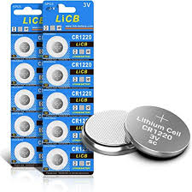
Payload Power Source
Type | Battery | Voltage | Capacity | Weight | Qty. Needed | Total Voltage | Total Weight
Lithium LiCB | CR2032 | 3.3V | 236mAh | 3.1g | 2 | 6.6V | 6.2g
Selection | Reason for Selection
Lithium LiCB CR2032 | - Smaller weight and easily scalable for more power
Battery Configuration
Two CR2032 in series to provide ~6V
Presenter: Paolo D’Alessandro

Slide 77
Payload Power Budget
Component​ | Voltage (V)​ | Power per Unit (W)​ | Duty Cycle (%)​ | Power Consumption (Wh)​ | Source
Raspberry Pi Pico (Microcontroller)​ | 9V​ | .1406​ | 100​ | 0.1406 | Datasheet
Adafruit Ultimate Breakout (GPS)​ | 5V​ | .1​ | 100​ | .1​ | Datasheet
BMP280​ (Air Temperature/Pressure)​ | 5V​ | 0.00025 | 100​ | 0.000025 | Datasheet
IE092505-1 (Sound Alert) | 5V​ | .03​ | 100​ | 50m​ | Datasheet
Xbee Pro 900 HP​ (Radio Module)​ | 5V​ | .0.95 | 100​ | .95​ | Datasheet
LED Light (Lighting Alert) | 2.2V | 0.044 | 100 | 0.044 | Datasheet
BNO 055 (Temp/Rotational Sensor) | 1.7-3.6V | 0.0123 | 100 | 0.00155 | Datasheet
Presenter: Paolo D’Alessandro

Slide 78
Flight Software (FSW) Design
Max Epstein

Slide 79
FSW Overview (1/2)
Flowchart
Start communication between payload and GCS
Process live altitude data
Boot up
Calibrate Sensors
Detect payload landing
Start payload parachute release
Terminate
telemetry
Start
Payload release
Raise Mast
Initiate audio beacon
Presenter: Max Epstein

Slide 80
FSW Overview (2/2)
Programming Languages | Python
Development Environments | Visual Studio Code
FSW Tasks | - Boot up and collect sensor data in the correct units required by CanSat. - Communicate telemetry from the payload and container to the GCS to store data. - Keep track of altitude and release the payload and parachute when needed. - Trigger audio beacon after landing.
Payload FSW | - Payload communication - In charge of collecting data with sensors - Contains temperature sensor, pressure sensor, rotational sensor, camera
Presenter: Max Epstein

Slide 81
FSW Changes Since PDR
No Changes have been made since the PDR
Presenter: Max Epstein

Slide 82
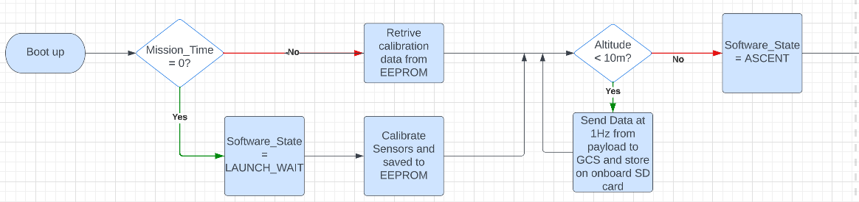
Payload CanSat FSW State Diagram (1/3)
Presenter: Max Epstein

Slide 83
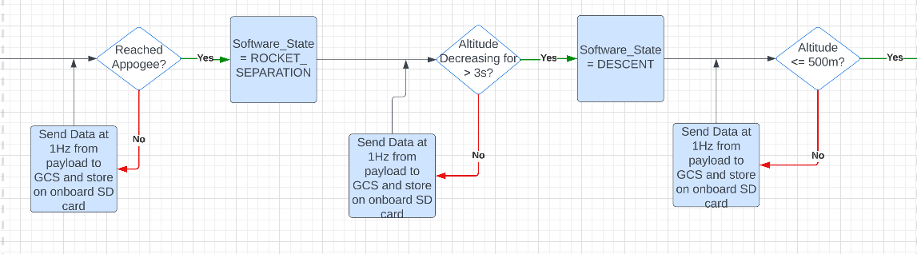
Payload CanSat FSW State Diagram (2/3)
Presenter: Max Epstein

Slide 84
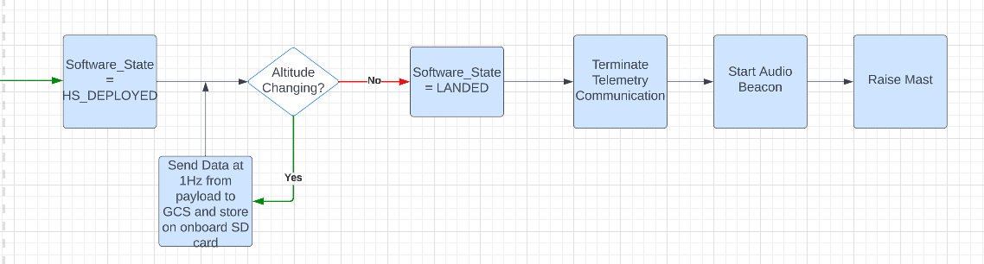
Payload CanSat FSW State Diagram (3/3)
Presenter: Max Epstein

Slide 85
Payload CanSat FSW State Diagram
FSW Recovery from Reset
What is used to recover:
Mission Time
GPS Time
Software State
Altitude
Causes that call for reset:
Power loss (power supply)
Physical damage
Processor failure
Presenter: Max Epstein

Slide 86
Simulation Mode Software
Sensor changes
All air pressure sensors disabled
Simulation mode commands
<MODE> switches from 'F' (Flight) to 'S' (Simulation)
How is simulated sensor data substituted with real data?
External data from text file fed into certain fields instead of air pressure sensor readings
<ALTITUDE>, <PRESSURE>
All other sensor readings & telemetry remain the same
Presenter: Max Epstein

Slide 87
Software Development Plan (1/2)
Prototyping and Prototyping Environments
Environment in Visual Studio Code and Arduino IDE
Modular code parts
Development Team
Max Epstein
Dylan Falzone
Yashas Shivaram
Paolo D’Alessandro
Test Methodology
Simulation mode with varying datasets.
Freefall sensor testing
Presenter: Max Epstein

Slide 88
Software Development Plan (2/2)
Subsystem​ | Development Sequence​
Sensors​ | Sensor trade and selection compare and select the best Program each individual sensor in Arduino Integrate and conglomerate all programs, make sure it still functions
Xbee Radio​ | Configure and test point to point communication for the radio (controller and GCS port)​ Integrate sensors with Xbee for data transmission
Flight Control​ | Program feedback system with servos connected to flight mechanisms​
Release Mechanisms​ | Program release mechanisms such as linear actuators​
Software State​ | Use the data from sensors to change the states
Audio Beacon​ | Program locator audio beacon​
Integration​ | Integrate all software subsystem and ensure 1Hz data transmission from payload. Also, to make sure the software states match up with what is occurring.
Presenter: Max Epstein

Slide 89
Ground Control System (GCS) Design
Dylan Falzone, Max Epstein

Slide 90
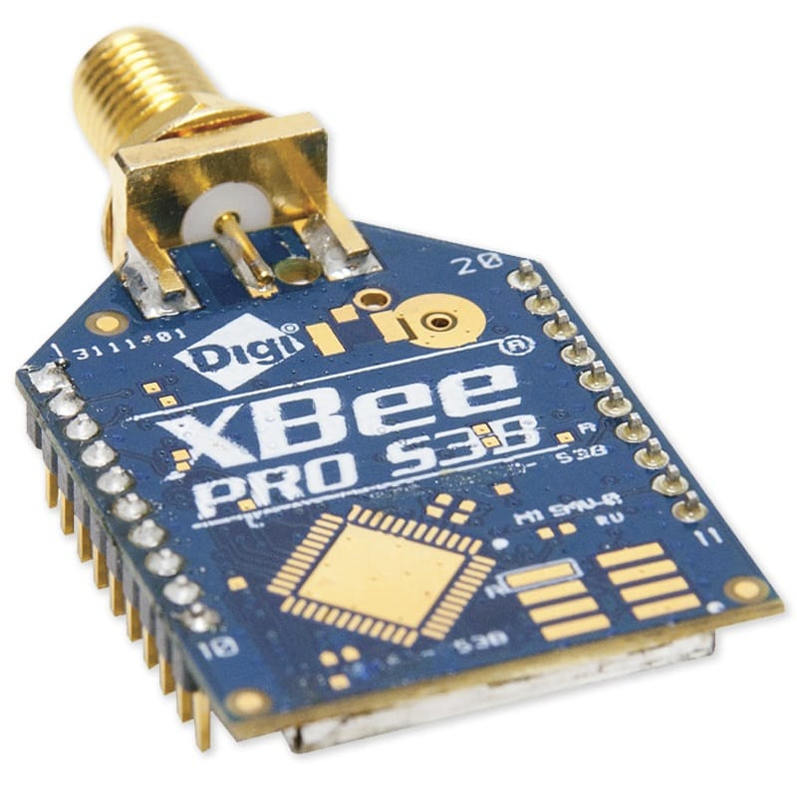
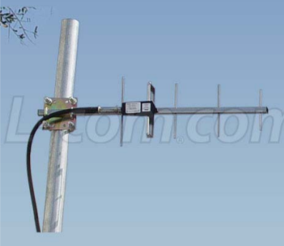
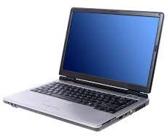
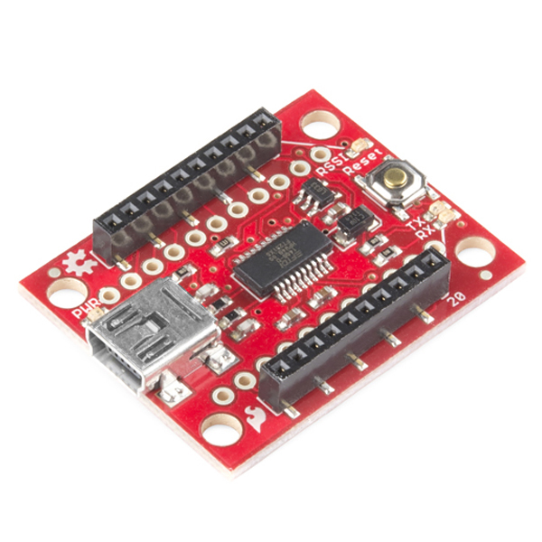
GCS Overview
Flight Software
Presenter: Dylan Falzone

Slide 91
GCS Changes Since PDR
No changes have been made since the PDR
Presenter: Dylan Falzone

Slide 92

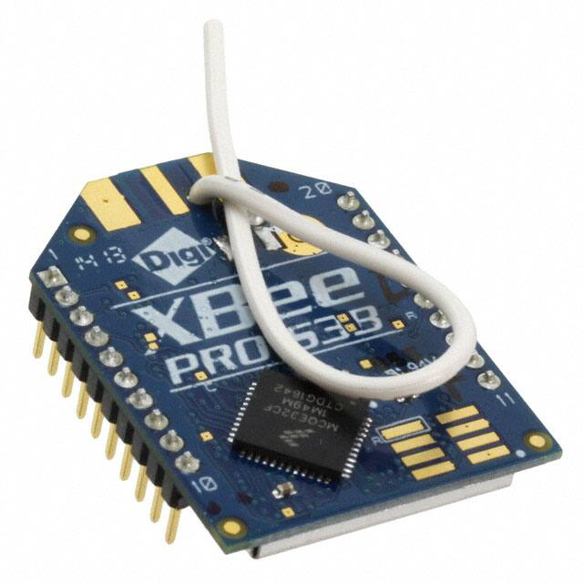

GCS Design
Specifications​
Laptop Battery | 4 Hours
Overheating Mitigation | Umbrella & Laptop Cooler
Auto update Mitigation | Disable Auto-Update
Presenter: Dylan Falzone

Slide 93
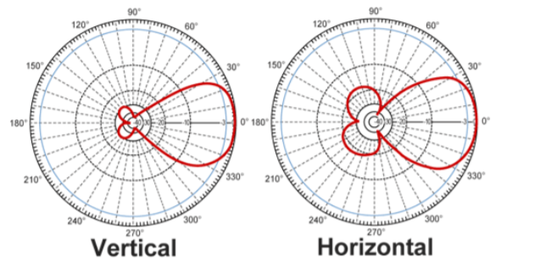

GCS Antenna
Name​ | Frequency ​ Range (GHz)​ | Length of Antenna (mm)​ | Gain (dBi)​ | Polarization | Connection Type​ | Weight (g) | Cost ($)
900 MHz 14 dBi Al Yagi Antenna | .90-.928 | 1422 | 14 | Linear | N-Female | 680 | 72.32
Selection​ | Reasoning for selection​
Yagi Antenna | - Gain strength immensely stronger than the other antennas - Larger antenna - Ideal frequency range - Handheld, easy to maneuver
Presenter: Dylan Falzone

Slide 94
GCS Software (1/3)
Software Packages:
• Python 3.9.7 - Computational environment of choice
• XCTU – XBee Program Software
• XBEE Python Library – real time access to XBEE via USB interface
• Matplotlib Python Library – real time plotting and data manipulation
• PySimpleGUI Python Library – visual design layout and manipulation
• Pandas Python Library – real time data collection and .csv file status
Command Software and Interface:
• Commands can be sent from the Ground Control Station to the CanSat via command.
• The GCS uses the XBEE Python Library to access the XBEE receiver through the USB interface.
Telemetry Data Recording:
• Telemetry will be saved in a .csv file without manipulation after being read via USB interface.
• .csv data will be analyzed in python and presented via GUI and saved in file.
CSV File Generation:
• .csv file will be generated in GCS Python software for payload and data will be continuously added to the created file as it arrives in packets to GCS.
Presenter: Max Epstein

Slide 95

GCS Software (2/3)
Presenter: Max Epstein

Slide 96

GCS Software (3/3)
Presenter: Max Epstein

Slide 97
CanSat Integration and Test
Jordi Rey

Slide 98
CanSat Integration and Test Overview
Subsystem Level
Integrated Level
Environmental
Sensors
CDH
EPS
Radio communications
FSW
Mechanical
Descent Control
Descent testing
Communications
Mechanisms
Deployment
Simulation
Drop test​
Thermal test​
Vibration test​
Fit Check​
Vacuum test
Test Plan
Subsystem Level | Each subsystem listed in this page will be performed
Integrated Level | Integrated tests will be performed after payload and container are built
Environmental | Fit check will be performed on the container and the other tests will be performed on the assembled CanSat
Presenter: Jordi Rey

Slide 99
Subsystem Level Testing Plan (1/2)
Subsystem Level Testing​
Sensors​ | Pressure sensor tests Temperature sensor tests GPS location & time tests​ Camera recording and saving video tests Altimeter tests
CDH​ | Processor clock speed tests​ EEPROM storage size tests​ EEPROM read/write speed tests​
EPS​ | Battery voltage readings​ Impedance tests on each component​ Battery power output & tolerance tests​
Radio Communications | XBEE radio receiver/sender tests Antenna signal quality tests Packet receival and transmission tests
Presenter: Jordi Rey

Slide 100
Subsystem Level Testing Plan (2/2)
Subsystem Level Testing​
FSW​ | Data live graph generation tests Simulation mode tests CSV data saving & handling Software states testing
Mechanical​ | Container & probe structural tests Probe deployment tests Probe upright testing Avionics bay structural integrity tests Parachute deployment and release tests Probe stability control tests Flag raising test
Descent Control​ | Parachute deployment tests Aerobraking device testing Descent stability testing
Presenter: Jordi Rey

Slide 101
Integrated Level Functional Test Plan
Testing Plan
Decent Testing | PID Controller payload descent rate tests
Communications | Telemetry transmission and retrieval tests Communication between GCS and Payload
Mechanisms | Payload release mechanism tests Payload stability control tests Aerobrake release mechanism tests Flag deployment mechanism tests Payload parachute release mechanism tests
Deployment | Payload deployment tests at various altitudes Payload parachute deployments tests at various altitudes Aerobrake deployments tests at various altitudes Linear actuator integration with altitude sensor readings
Simulation | Software state tests Activation command testing Sensor readings and telemetry remain unchanged Text file reading and overriding
Presenter: Jordi Rey

Slide 102


Environmental Test Plan (1/3)
Drop Test
Thermal Test
The CanSat will be tied to a 61 cm 1/8 inch thick kevlar rope to an 80/20 aluminum high surface structure with a height of at least 1 meter
The CanSat will be powered on and verified that telemetry is being received
The CanSat will be raised so the attachment point on the parachute is at the same height as the structure's ceiling and released
It will be checked if the CanSat is still operational and receiving telemetry
The CanSat will be turned on and then placed in an insulating cooler
The cooler will be sealed and set to 60 degrees Celsius using a hairdryer
The thermal test will run for two hours maintaining a temperature between 55 and 60 degrees Celsius
Visual inspection and functional tests will be conducted to verify the CanSat survived and can still operate
Presenter: Jordi Rey

Slide 103



Environmental Test Plan (2/3)
Drop Test
Vibration Test
Vacuum Test
The CanSat will be placed in a wooden support structure to hold the CanSat
The sander will be turned on and then powered off to a full stop 5 seconds after reaching full speed
The previous step will be repeated four more times
The CanSat will be visually inspected for damage and functionality
It will be verified that the accelerometer data is being collected
The CanSat will be turned on and suspended in a 5-gallon bucket
A lid made of 6 mm thick polycarbonate sheet will be placed on top of the bucket
A vacuum cleaner will be turned on to pull a vacuum inside the bucket
The telemetry will be collected, and the vacuum turned off at peak altitude
Presenter: Jordi Rey

Slide 104
Environmental Test Plan (3/3)
Fit Check
A 125 mm diameter hole will be cut from a piece of cardboard
The width of the CanSat will be tested using the 125 mm diameter hole to see if anything is touching
Presenter: Jordi Rey

Slide 105
Test Procedures Descriptions (1/5)
Drop Test
Test Proc | Test Description | Requirements | Pass Fail Criteria
1 | Power on the CanSat | 23, 24 | Pass if CanSat powers on. Otherwise fail.
2 | Verify telemetry is being received. | 38, 39, 40 | Pass if data is received. Otherwise fail.
3 | Raise CanSat by the attached cord, so that the two attachment points of the cord are at the same height. |  | N/A
4 | Release the CanSat. |  | N/A
5 | Verify the CanSat did not lose power. | 38, 44, 45 | Pass if CanSat doesn't lose power. Otherwise fail.
6 | Inspect for any damage, or detached parts. | 12, 13, 15 | Pass if there is no damage. Otherwise fail.
7 | Verify telemetry is still being received. | 30 | Pass if data is still receiving. Otherwise fail.
8 | Power down CanSat. | 23, 24 | Pass if CanSat turns off. Otherwise fail.
Presenter: Jordi Rey

Slide 106
Test Procedures Descriptions (2/5)
Thermal Test
Test Proc | Test Description | Requirements | Pass Fail Criteria
1 | Place CanSat into a thermal chamber. |  | N/A
2 | Power on the CanSat. | 23, 24 | Pass if CanSat powers on. Otherwise fail.
3 | Close and seal the thermal chamber and turn on the heat source. |  | N/A
4 | Monitor the temperature and turn off the heat source when the internal temperature reaches 60C and turn on the heat source when the temperature drops to 55C, while maintaining the test conditions for two hours. |  | N/A
5 | Turn off the heat source and perform visual inspection and any functional tests to verify the CanSat survived the thermal exposure and can operate as expected. | 38, 39, 40 44, 45 | Pass if CanSat operates as expected. Otherwise fail.
6 | With the CanSat still hot, test any mechanisms and structures to make sure the integrity has not been compromised. Take precautions to avoid injury. Verify epoxy joints and composite materials still maintain their strengths. | 15, 30, 31 | Pass if everything is intact. Otherwise fail.
7 | Verify that CanSat is still sending data to GCS 47 | 38, 39 | Pass if data is being sent. Otherwise fail.
8 | Power down CanSat. | 23, 24 | Pass if CanSat can turn off. Otherwise fail.
Presenter: Jordi Rey

Slide 107
Test Procedures Descriptions (3/5)
Vibration Test
Test Proc | Test Description | Requirements | Pass Fail Criteria
1 | Power on the CanSat. | 23, 24 | Pass if CanSat powers on. Otherwise fail.
2 | Verify accelerometer data is being collected. | 38, 39 | Pass if accelerometer data is received on the Ground Control Station. Otherwise fail.
3 | Power up the sander. |  | N/A
4 | Once the sander is up to full speed, wait 5 seconds. |  | N/A
5 | Power down the sander to a full stop. |  | N/A
6 | Repeat steps 3 to 5 four more times. |  | N/A
7 | Inspect the CanSat for damage and functionality. | 12, 13, 15 | Pass if CanSat maintains function and structural integrity with no damage to mounting or connections. Otherwise fail.
8 | Verify accelerometer data is still being collected. | 15 | Pass if accelerometer data is received on the Ground Control Station. Otherwise fail.
9 | Power down CanSat. | 23, 24 | Pass if CanSat can turn off. Otherwise fail.
Presenter: Jordi Rey

Slide 108
Test Procedures Descriptions (4/5)
Vacuum Test
Test Proc | Test Description | Requirements | Pass Fail Criteria
1 | Suspend the fully configured and powered CanSat in the vacuum chamber. | 23, 24 | Pass if CanSat powers on. Otherwise fail.
2 | Turn on the vacuum to start pulling a vacuum. |  | N/A
3 | Monitor the telemetry and stop the vacuum when the peak altitude has been reached. | 38, 39 | N/A
4 | Let the air enter the vacuum chamber slowly and monitor the operation of the CanSat. | 15 | Pass if CanSat operates as expected. Otherwise fail.
5 | Collect and save telemetry. | 44, 45, 51 | Pass if data is received. Otherwise fail.
6 | Make the saved telemetry available for the judges to review. | 56, 57 | Pass if data is saved. Otherwise fail.
7 | Power down CanSat. | 23, 24 | Pass if CanSat can turn off. Otherwise fail.
Presenter: Jordi Rey

Slide 109
Test Procedures Descriptions (5/5)
Fit Check
Test Proc | Test Description | Requirements | Pass Fail Criteria
1 | Cut 125 mm diameter circle in cardboard |  | N/A
2 | Place CanSat through the hole in the cardboard |  | Pass if CanSat diameter is < 125mm. Otherwise fail.
3 | Inspect CanSat for sharp edges that prevent it from smoothly deploying from the rocket | 2,3 | Pass if no sharp edges. Otherwise fail.
Presenter: Jordi Rey

Slide 110
Simulation Test Plan
How simulation works
After configuration, once the SIM ENABLE and SIM ACTIVATE commands are ran, simulation mode will run.
The ground station will transmit pressure data from a csv file at 1Hz intervals to the payload.
What parts are tested
The configuration and echoing of commands.
The flight software will determine altitude using radio linked values instead of live sensor data.
The flight software will detect the launch and release payload and parachute at respective altitudes.
Lastly, the mast will be raised and the audio beacon will begin once landing is detected
The deployment of payload parachute, mast raise, and trigger of audio beacon.
The calculation of altitude with fed data from the CSV.
Payload video is saved
Presenter: Jordi Rey

Slide 111
Mission Operations & Analysis
Melissa Gonzalez Grospe

Slide 112

Overview of Mission Sequence of Events (1/2)
Flowchart
Presenter: Melissa Gonzalez Grospe

Slide 113
Overview of Mission Sequence of Events (2/2)
Roles & Responsibilities
• Mission Control Officer – Savari Datta
• Ground Station Crew – Christian Roque, Max Epstein, and Yashas Shivaram
• Recovery Crew – Jordi Rey and Daniel Horton
• CanSat Crew – Paolo D'Alessandro, Jovana Markovic, Melissa Gonzalez Grospe, Dylan Falzone, Savari Datta, Jordi Rey
Launch-Day
Pre-Launch
Arrive at launch site
Inspect CanSat damage
Fit check CanSat
Inspect Payload damage
Secure payload within container
Construct handheld antenna and setup ground control station
Check telemetry between CanSat and GCS
Properly integrate CanSat to rocket
Launch
Conduct launch procedure
Monitor telemetry data transmission
Perform flight operations
Track container
Post-Launch
Locate container using GPS and visual cues
Ensure all field scores are filled in
GCS data is reduced and downloaded onto thumb drive
Thumb drive is given to competition officials
Prepare for PFR
Presenter: Melissa Gonzalez Grospe

Slide 114
Field Safety Rules Compliance
Mission Operations Manual
GCS Configuration
CanSat Preparation
CanSat-Rocket Integration
I. Ground Station Setup Procedure
II. Communication Tests
III. Antenna Tests
Launch Preparation and Procedure
I. CanSat Assembly Procedure
II. Payload to CanSat Integration
III. Damage and System Inspection
I. Fit Check
II. CanSat Parachute Preparation
I. Provided by Competition
Removal Procedure
I. Provided by Competition
Development Status of Mission Operations Manual:
CanSat Assembly Procedure in progress
Other sections yet to be started
Presenter: Melissa Gonzalez Grospe

Slide 115
CanSat Location and Recovery
Container Recovery:
Container will be a bright pink to aid in the recovery effort
Parachute will be a bright orange to help visually track the container and probe as they descend
Container audio beacon will activate once landed
Last logged GPS position will be used to locate the container
Container Return Address
Yes we CANSAT, University of Florida Team 1032, savaridatta@ufl.edu Mechanical and Aerospace Engineering Building A, University of Florida, 313 Florida, United States of America
Presenter: Melissa Gonzalez Grospe

Slide 116
Mission Rehearsal Activities
Activities | Rehearsal | Description
Ground System Radio Link Procedures | No | XBee settings check Antenna and XBee communication check Data transmission check
Powering on/off the CanSat | No | Switch is flicked to turn on CanSat and flicked to turn off
Launch Configuration Preparations | No | Fit check Payload is integrated into container Parachute folding procedure
Loading the CanSat in Launch Vehicle | No | CanSat to rocket integration
Telemetry processing, archiving, and analysis | No | Ground station receives all telemetry data Data is transferred onto CSV file Data is processed and displayed in real time Data transfer is ended once container lands
Recovery | No | Fluorescent container will be tracked during flight Container buzzer will be listened to and followed Video data from payload and container transferred to thumb drive
Presenter: Melissa Gonzalez Grospe

Slide 117
Requirements Compliance
Yashas Shivaram

Slide 118
Requirements Compliance Overview
Yes we CANSAT’s project complies with the requirements of the CanSat 2023 mission
The requirement compliance was measure using three conditions which are detailed below: Full Compliance, Partial Compliance, and No Compliance.
Full Compliance​ | The CanSat project complies 53/61 mission requirements
Partial​ Compliance | There are 8 requirements partially satisfied by our CanSat. This means that the requirement is technically met but will require further analysis and testing for finalization.
No Compliance | There are 0 requirements our current build does not comply to
Presenter: Yashas Shivaram

Slide 119
Requirements Compliance
Req # | Description​ | Comply / No Comply / Partial | X-Ref Slide(s) Demonstrating Compliance | Team comments or notes
1​ | Total mass of the CanSat (science payloads and container) shall be 700 grams +/- 10 grams. | Comply | 17
2​ | CanSat shall fit in a cylindrical envelope of 125 mm diameter x 400 mm length. Tolerances are to be included to facilitate container deployment from the rocket fairing. | Comply | 17
3​ | The container shall not have any sharp edges to cause it to get stuck in the rocket payload section which is made of cardboard. | Comply | 19 | Sides will be sanded
4​ | The container shall be a fluorescent color; pink, red or orange. | Comply | 44, 99
5​ | The container shall be solid and fully enclose the science probes. Small holes to allow access to turn on the science probes are allowed. The end of the container where the probe deploys may be open. | Comply |  | Added since the PDR
6​ | The rocket airframe shall not be used to restrain any deployable parts of the CanSat. | Comply | 41
7​ | The rocket airframe shall not be used as part of the CanSat operations. | Comply | 41
8​ | The container’s parachute shall not be enclosed in the container structure. It shall be external and attached to the container so that it opens immediately when deployed from the rocket. | Comply | 44
9​ | The Parachutes shall be fluorescent Pink or Orange | Comply | 99
10​ | The descent rate of the CanSat (container and science probe) shall be 15 meters/second +/- 5m/s. | Comply | 38
Presenter: Yashas Shivaram

Slide 120
Requirements Compliance
Req # | Description​ | Comply / No Comply / Partial | X-Ref Slide(s) Demonstrating Compliance | Team comments or notes
11​ | 0 altitude reference shall be at the launch pad. | Comply | 85
12 | All structures shall be built to survive 15 Gs of launch acceleration. | Partial | 39 | Needs Testing
13 | All structures shall be built to survive 30 Gs of shock | Partial | 39 | Needs Testing
14 | All electronics and mechanical components shall be hard mounted using proper mounts such as standoffs, screws, or high-performance adhesives. | Comply | 41-46
15 | All mechanisms shall be capable of maintaining their configuration or states under all forces. | Partial | 39 | Needs Testing
16 | Mechanisms shall not use pyrotechnics or chemicals. | Comply | 41
17 | Mechanisms that use heat (e.g., nichrome wire) shall not be exposed to the outside environment to reduce potential risk of setting vegetation on fire. | Comply | 41
18 | Both the container and payload shall be labeled with team contact information including email address. | Comply | 99
19 | Cost of the CanSat shall be under $1000. Ground support and analysis tools are not included in the cost. Equipment from previous years should be included in this cost, based on current market value. | Comply | 51-55
20 | XBEE radios shall be used for telemetry. 2.4 GHz Series radios are allowed. 900 MHz XBEE radios are also allowed. | Comply | 60
21 | XBEE radios shall have their NETID/PANID set to their team number. | Comply | 60
Presenter: Yashas Shivaram

Slide 121
Requirements Compliance
Req # | Description​ | Comply / No Comply / Partial | X-Ref Slide(s) Demonstrating Compliance | Team comments or notes
22 | XBEE radios shall not use broadcast mode. | Comply | 60
23 | The container and probe shall include an easily accessible power switch that can be accessed without disassembling the CanSat and science probes and in the stowed configuration. | Partial | 67,68
24 | The probe shall include a power indicator such as an LED or sound generating device that can be easily seen or heard without disassembling the CanSat and in the stowed state. | Comply | 67
25 | An audio beacon is required for the probe. It shall be powered after landing. | Comply | 67, 75
26 | The audio beacon shall have a minimum sound pressure level of 92 dB, unobstructed. | Partial | 28 | Needs Testing
27 | Battery source may be alkaline, Ni-Cad, Ni-MH or Lithium. Lithium polymer batteries are not allowed. Lithium cells must be manufactured with a metal package similar to 18650 cells. Coin cells are allowed. | Comply | 68
28 | An easily accessible battery compartment shall be included allowing batteries to be installed or removed in less than a minute and not require a total disassembly of the CanSat. | Comply | 17
29 | Spring contacts shall not be used for making electrical connections to batteries. Shock forces can cause momentary disconnects. | Comply | 81-89
30 | The Cansat shall operate during the environmental tests laid out in Section 3.5. | Comply | 93
31 | The Cansat shall operate for a minimum of two hours when integrated into the rocket. | Comply | 58
32 | The probe shall be released from the container when the CanSat reaches 500 meters. | Comply | 45
Presenter: Yashas Shivaram

Slide 122
Requirements Compliance
Req # | Description​ | Comply / No Comply / Partial | X-Ref Slide(s) Demonstrating Compliance | Team comments or notes
33 | The probe shall deploy a heat shield after leaving the container. | Comply | 47-48
34 | The heat shield shall be used as an aerobrake and limit the descent rate to 20 m/s or less. | Comply | 31, 35-34
35 | At 200 meters, the probe shall release a parachute to reduce the descent rate to 5 m/s +/- 1m/sec. | Comply | 49, 38
36 | Once landed, the probe shall upright itself. | Partial | 50 | No active uprighting, more testing
37 | After uprighting, the probe shall deploy a flag 500 mm above the base of the probe when the probe is in the upright position. | Comply | 41
38 | The probe shall transmit telemetry once per second. | Comply | 60, 75, 92
39 | The probe telemetry shall include altitude, air pressure, temperature, battery voltage, probe tilt angles, command echo, and GPS coordinates that include latitude, longitude, altitude and number of satellites tracked. | Comply | 61
40 | The probe shall include a video camera pointing down to the ground. | Comply | 28
41 | The video camera shall record the flight of the probe from release to landing. | Comply | 28
42 | The video camera shall record video in color and with a minimum resolution of 640x480. | Comply | 28
44 | The flight software shall maintain a count of packets transmitted which shall increment with each packet transmission throughout the mission. The value shall be maintained through processor resets | Comply | 61
45 | The probe shall maintain mission time throughout the whole mission even with processor resets or momentary power loss. | Comply | 61
Presenter: Yashas Shivaram

Slide 123
Requirements Compliance
Req # | Description​ | Comply / No Comply / Partial | X-Ref Slide(s) Demonstrating Compliance | Team comments or notes
46 | The probe shall have its time set to within one second UTC time prior to launch. | Comply | 64
47 | The probe flight software shall support simulated flight mode where the ground station sends air pressure values at a one second interval using a provided flight profile csv file. | Partial |  | Needs testing
48 | In simulation mode, the flight software shall use the radio uplink pressure values in place of the pressure sensor for determining the container altitude. | Partial |  | Needs testing
49 | The container flight software shall only enter simulation mode after it receives the SIMULATION ENABLE and SIMULATION ACTIVATE commands. | Comply | 63, 65, 94
50​ | The ground station shall command the CanSat to start calibrating the altitude to zero when the CanSat is on the launch pad prior to launch. | Comply | 64
51​ | The ground station shall generate csv files of all sensor data as specified in the Telemetry Requirements section. | Comply | 86
52​ | Telemetry shall include mission time with 0.01 second or better resolution. | Comply | 61
53​ | Configuration states such as zero altitude calibration shall be maintained in the event of a processor reset during launch and mission. | Comply | 73
54​ | Each team shall develop their own ground station. | Comply | 81
55 | All telemetry shall be displayed in real time during descent on the ground station. | Comply | 85
56 | All telemetry shall be displayed in engineering units (meters, meters/sec, Celsius, etc.) | Comply | 85
Presenter: Yashas Shivaram

Slide 124
Requirements Compliance
Req # | Description​ | Comply / No Comply / Partial | X-Ref Slide(s) Demonstrating Compliance | Team comments or notes
57​ | Teams shall plot each telemetry data field in real time during flight. | Comply | 85
58​ | The ground station shall include one laptop computer with a minimum of two hours of battery operation, XBEE radio and a hand-held antenna. | Comply | 81
59​ | The ground station must be portable so the team can be positioned at the ground station operation site along the flight line. AC power will not be available at the ground station operation site | Comply | 81
60​ | The ground station software shall be able to command the container to operate in simulation mode by sending two commands, SIMULATION ENABLE and SIMULATION ACTIVATE. | Comply | 84, 94
61 | When in simulation mode, the ground station shall transmit pressure data from a csv file provided by the competition at a 1 Hz interval to the cansat. | Comply | 84, 94
Presenter: Yashas Shivaram

Slide 125
Management
Savari Datta

Slide 126
Status of Procurements
All components and electronics to be used in the final design of the CanSat and the Ground Control Station have been bought prior to the submission of the CDR.
Parachutes are currently ordered but not delivered
In terms of electronics, several backup units were bought in order to account for damage during testing and travel.
All CanSat structural components also have several backup units to account for damage during testing and travel.
Procurement of our CanSat’s components is partially completed
Presenter: Savari Datta

Slide 127
CanSat Budget – Hardware
Component​ | Quantity​ | Unit Price ($)​ | Total Price ($)​ | Value Type​
Adafruit BMP280 | 2​ | 9.95 | 19.90 | Actual​
BNO-055 | 1​ | 34.95 | 34.95​ | Actual​
Adafruit Ultimate | 1 | 29.95​ | 29.95 | Actual​
Raspberry Pi Pico | 1​ | 4.50​ | 4.50​ | Actual​
ANT-900-RP-2-A | 1​ | 3.99​ | 3.99​ | Actual​
Arducam Mini | 1 | 25.99​ | 25.99 | Actual​
Mirco SD cards | 1​ | 4.20​ | 4.20​ | Actual​
Micro SD Readers | 1 | 8.00 | 8.00​ | Actual​
XBEE Pro 900 Mhz Radio | 1 | 68.25​ | 68.25 | Actual​
2032 Cell Batteries | 4​ | 1.20 | 4.80​ | Actual​
Arduino Nano | 1 | 20.70 | 20.70 | Actual
ABS Filament 1.75mm ABS, 1 kg | 1 | 22.99 | 22.99 | Actual
Springs | 6 | 1.08 | 6.48 | Actual
Tie Down Ring | 1 | 1.24 | 1.24 | Actual
Presenter: Savari Datta

Slide 128
CanSat Budget – Hardware
Component​ | Quantity​ | Unit Price ($)​ | Total Price ($)​ | Value Type​
Linear Actuator | 1 | 65.00 | 65.00 | Actual
Servo Motor | 1 | 8.84 | 8.84 | Actual
¼-20 Hex Nut | 2 | 9.81 | 9.81 | Actual
Steel Tape | 1 | 14.99 | 14.99 | Actual
Super Lube | 1 | 7.39 | 7.39 | Actual
Clock Spring | 1 | 8.38 | 8.38 | Estimate
JB Weld Plastic Bonder | 1 | 15.74 | 15.74 | Actual
Fiberglass Eyebolt | 1 | 5.66 | 5.66 | Actual
Aluminum threaded rods | 2 | 4.37 | 8.74 | Actual
¼ -20 Screw | 1 | 13.84 | 13.84 | Actual
Mylar Reflective Material | 1 | 6.69 | 6.69 | Actual
1ft Ultra-Light Parabolic Parachute | 1 | 46.00 | 46.00 | Actual
2ft Ultra-Light Parabolic Parachute | 1 | 56.00 | 56.00 | Actual
Plastic Coupling Nuts | 4 | 5.55 | 22.20 | Actual
PCB Screws | 4 | 1.25 | 5.00 | Actual
Presenter: Savari Datta

Slide 129
CanSat Budget – Hardware
Component​ | Quantity​ | Unit Price ($)​ | Total Price ($)​ | Value Type​
ChuteRelease | 1 | 139.95 | 139.95 | Actual
93181A411 Nut – Spool Mount (x100) | 1 | 5.95 | 5.95 | Actual
93070A064 M3 3mm Screws (x50) | 1 | 12.50 | 12.50 | Actual
90592A085 M3-0.5 hew nuts (x100) | 1 | 2.62 | 2.26 | Actual
Ripstop nylon | 1 | 0 | 0 | Actual
Presenter: Savari Datta

Slide 130
CanSat Budget – Other Costs
Component​ | Quantity​ | Unit Price ($)​ | Total Price ($)​ | Value Type​
Ground Station​ | -​ | -​ | -​ | -​
Xbee USB Shield​ | 1​ | 26.00​ | 26.00​ | Actual​
900 MHz 14 dBi Al Yagi Antenna | 1​ | 72.32​ | 72.32 | Actual​
900 MHz XBEE Radio | 1​ | 68.25 | 68.25 | Actual​
Laptop​ | 1​ | 1​ | 0​ | Provided by Team Member​
Prototyping ​ | 1​ | 1​ | 150.00​ | Estimate​
Test Supplies​ | 1​ | 1​ | 150.00​ | Estimate​
Test Facilities/​ Manufacturing Equipment​ | 1​ | 1​ | 0​ | Covered by University​
Presenter: Savari Datta

Slide 131
CanSat Budget – Other Costs
Source of Income:​ | Funds Provided ($):​
UF MAE Department​ | 4000.00​
Hardware Costs:​ | $650.44
Other Costs:​ | $466.57
Competition Fees: | $200.00
Total Costs:​ | $1317.01​
A total cost of $1057.09 for the testing and building of our CanSat as well as CanSat related fees leaves us with a total of $2682.99 for travel, housing, and food expense. This is expected to be more than sufficient for our 10 members.
Presenter: Savari Datta

Slide 132

Program Schedule Overview
The schedule below is a broad overlook of the 2022-2023 completion schedule for our team
The key below defines symbols for the more detailed schedule
Meetings in the Spring took place on Tuesdays and Wednesdays
KEY
Design Phase Overview | Important Action
Task | Holiday/Vacation
Presenter: Savari Datta

Slide 133

Detailed Program Schedule (1/2)
Presenter: Savari Datta

Slide 134

Detailed Program Schedule (2/2)
Presenter: Savari Datta

Slide 135


Shipping and Transportation
Entire CanSat project hardware will be carefully packed and transported to Virginia by car from Gainesville, Florida
Additional CanSat project supplies and tools will also be transported to Virginia from Gainesville.
Supplies are to be placed in boxes split by structure, electronics, and tools
Everything will be shipped a few days before the competition and stored in team member’s house (located in Virginia)
Presenter: Savari Datta

Slide 136
Conclusions
Major Accomplishments
All materials ordered CanSat container prototyped Prototype of Payload Basic telemetry in progress Parachute descent control methods developed
Major Unfinished Work
Prototype of full CanSat Full telemetry communication tests Testing of heatshield deployment mechanism
Testing to Complete
Vibration Test Thermal Test Drop Test Fit Check Vacuum Test
Flight Software Status
Radio Testing started Final software versions almost complete
Presenter: Savari Datta

